Slide 1
Implementing New Algorithms with CUDA Kernels
Notes:
In the previous section, we explored how asynchronous parallel algorithms can further enhance performance.
But what if there’s no parallel algorithm for your specific use case, or we can’t adapt existing ones with fancy iterators?
In this section, we’ll discuss your options for handling exactly that scenario.

Slide 2
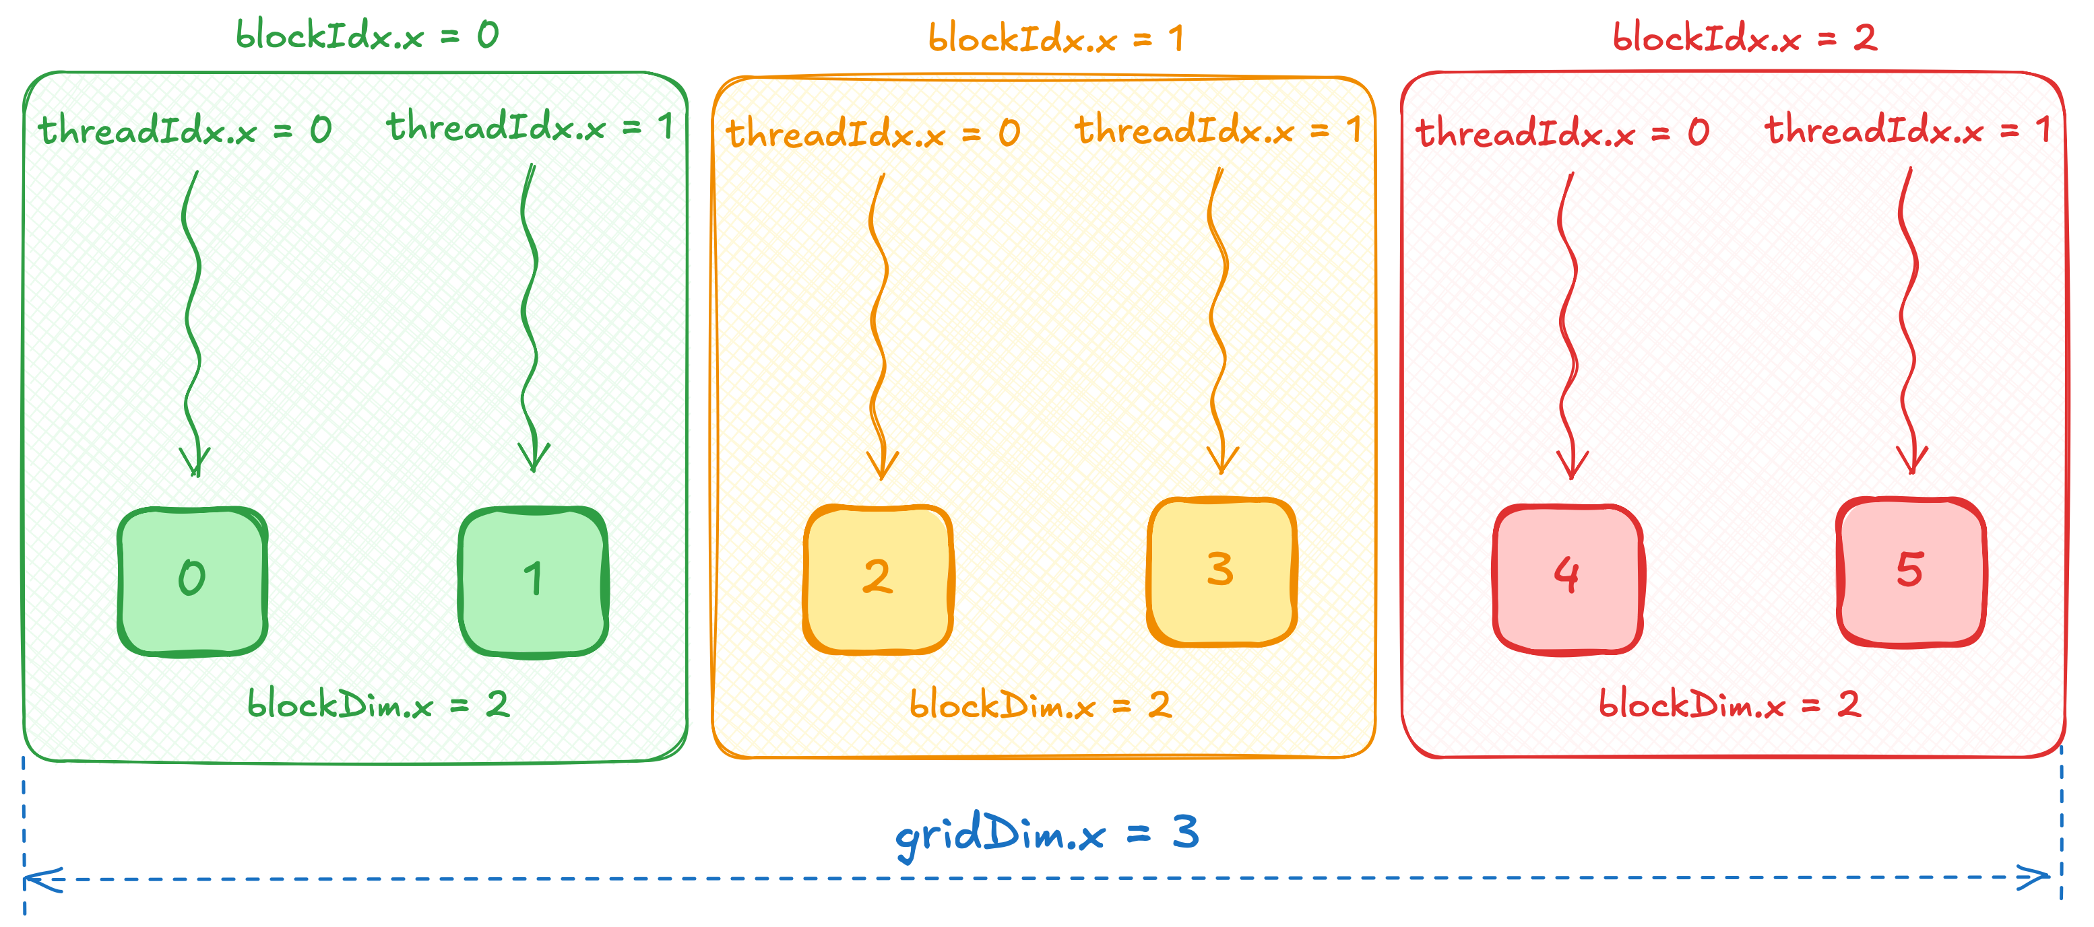
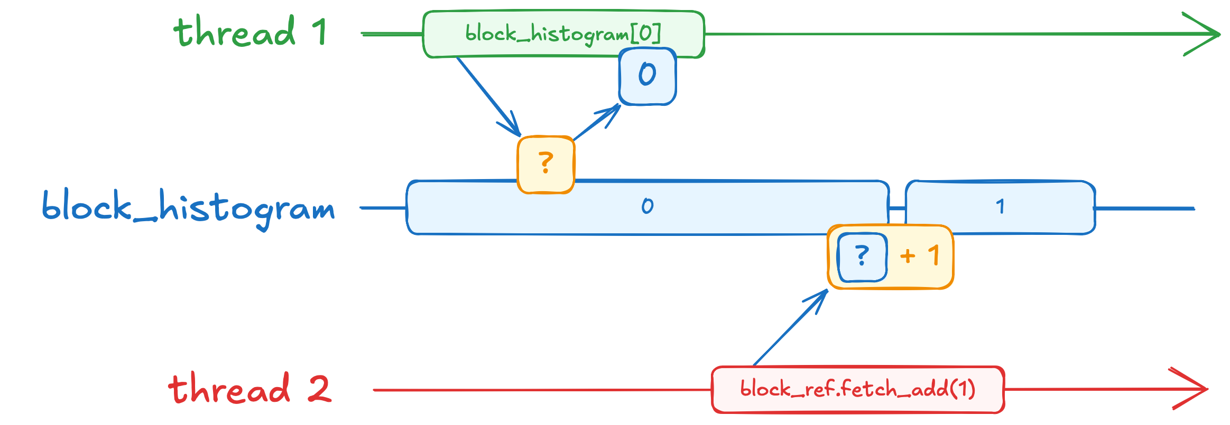
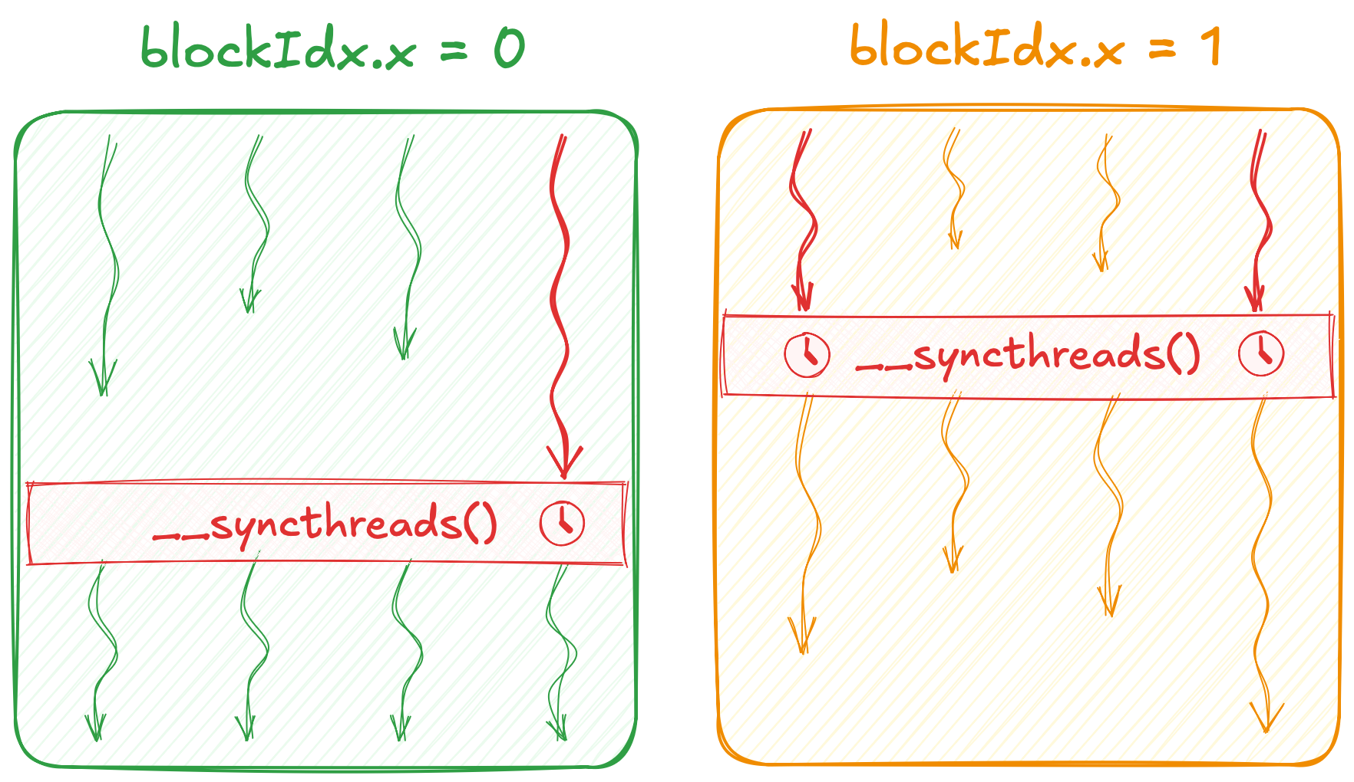
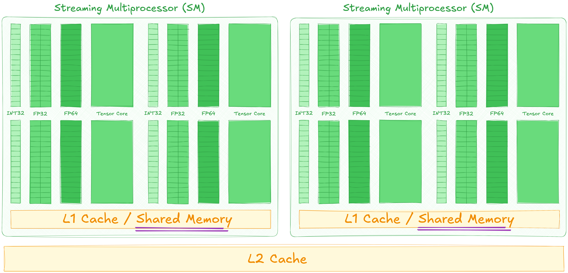
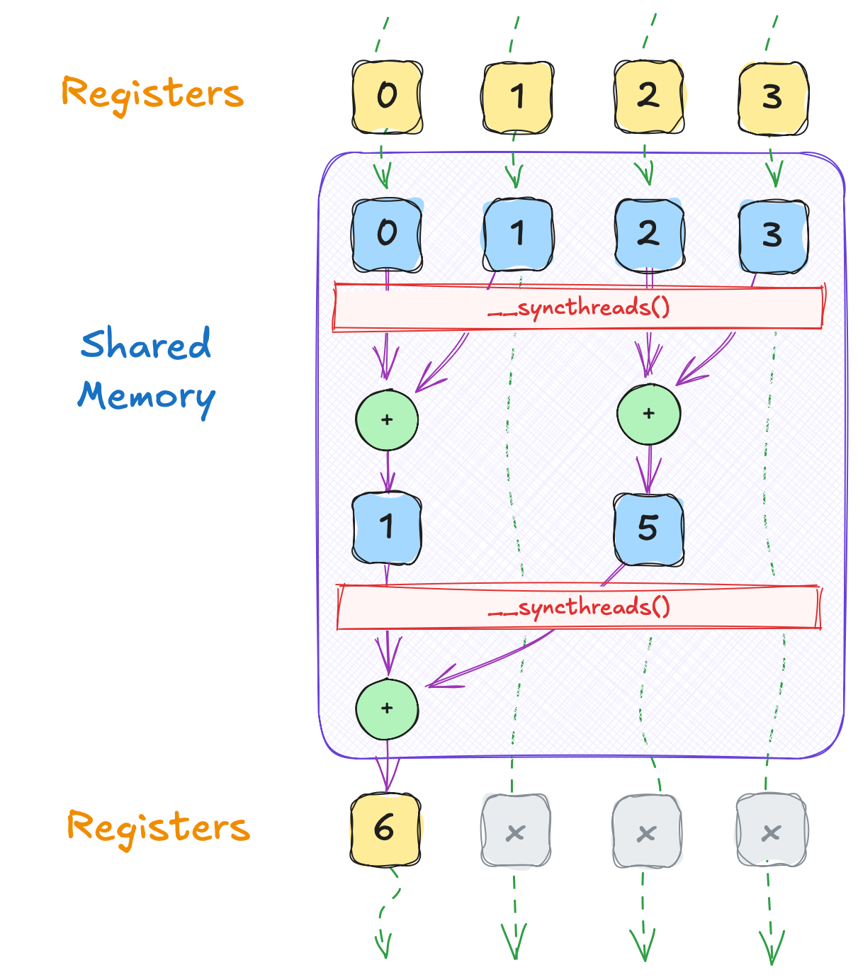
Section at a Glance
Learn the notion of 3.2 CUDA Kernels as we implement our first CUDA algorithm
Learn about 3.3 Atomics Memory operations
Learn the notion of thread block 3.4 Synchronization
Learn the notion of 3.5 Shared Memory as accelerate out kernel and achieve 4x speedup
Learn the notion of 3.6 Cooperative Algorithms as we coarse the grid and accelerate IO
Notes:
We’ll begin by exploring how to program GPUs directly, without relying on parallel algorithms.
Next, we’ll look at a few specialized vocabulary types that help us write correct and efficient concurrent programs.
After that, we’ll explore some hardware features that can significantly improve performance of our custom code.
Finally, we’ll discuss libraries that make low-level GPU programming much simpler.

Slide 3
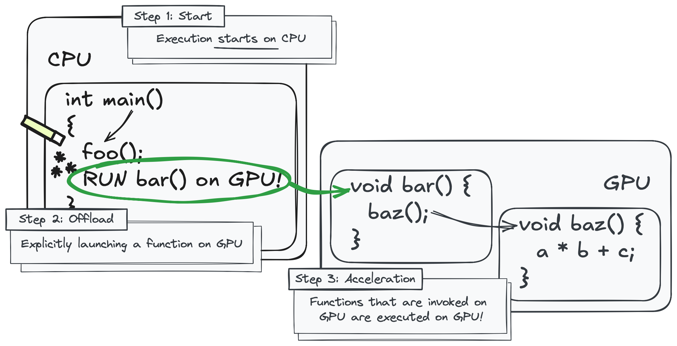
CUDA Kernels
CUDA libraries do not have magic powers to invoke code on GPU
When existing libraries don’t suit your use case, you’ll have to write your own GPU accelerated algorithms
To do so, you’ll have to understand how to launch work on GPU directly
Notes:
Remember, the CPU typically calls host functions, while the GPU calls device functions.
Invoking GPU work from the CPU requires a special mechanism.
So far, parallel algorithms handled this ‘magic’ for us, seamlessly calling GPU code behind the scenes.
Now that we want to implement our own algorithms without relying on those libraries, we need to understand how to launch GPU code ourselves.

Slide 4
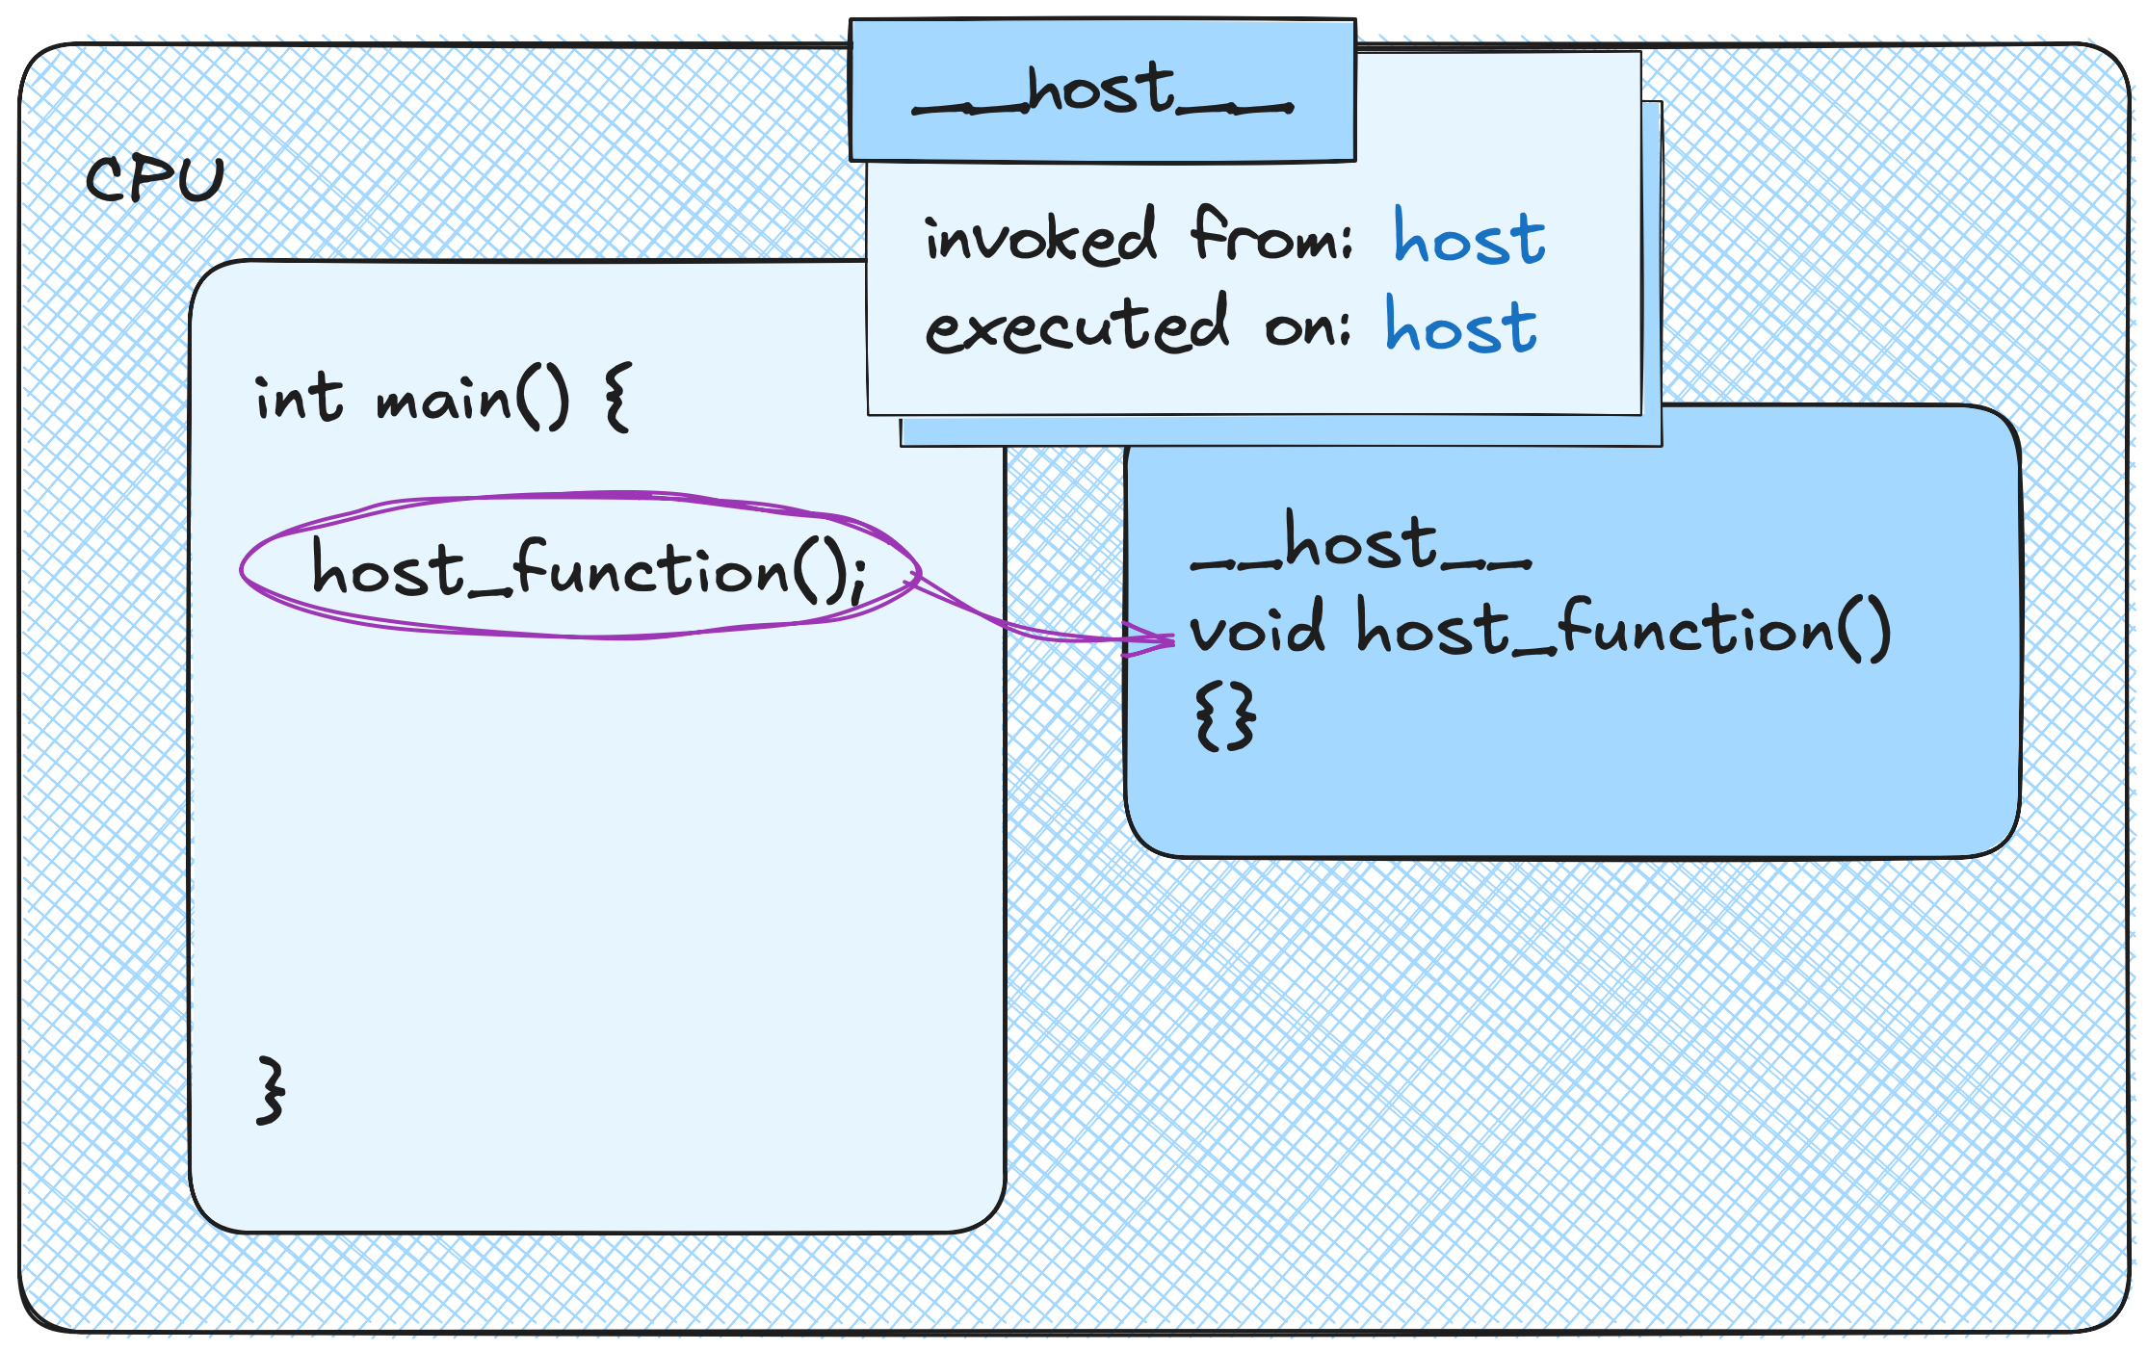
CUDA Kernels
All functions are implicitly __host__
Host functions are:
compiled into CPU instructions
invoked from host
executed on host
Notes:
But before diving in, let’s quickly recap the execution space specifiers we’ve encountered so far.
Host functions are compiled into CPU instructions, called from the host, and executed on the host.

Slide 5
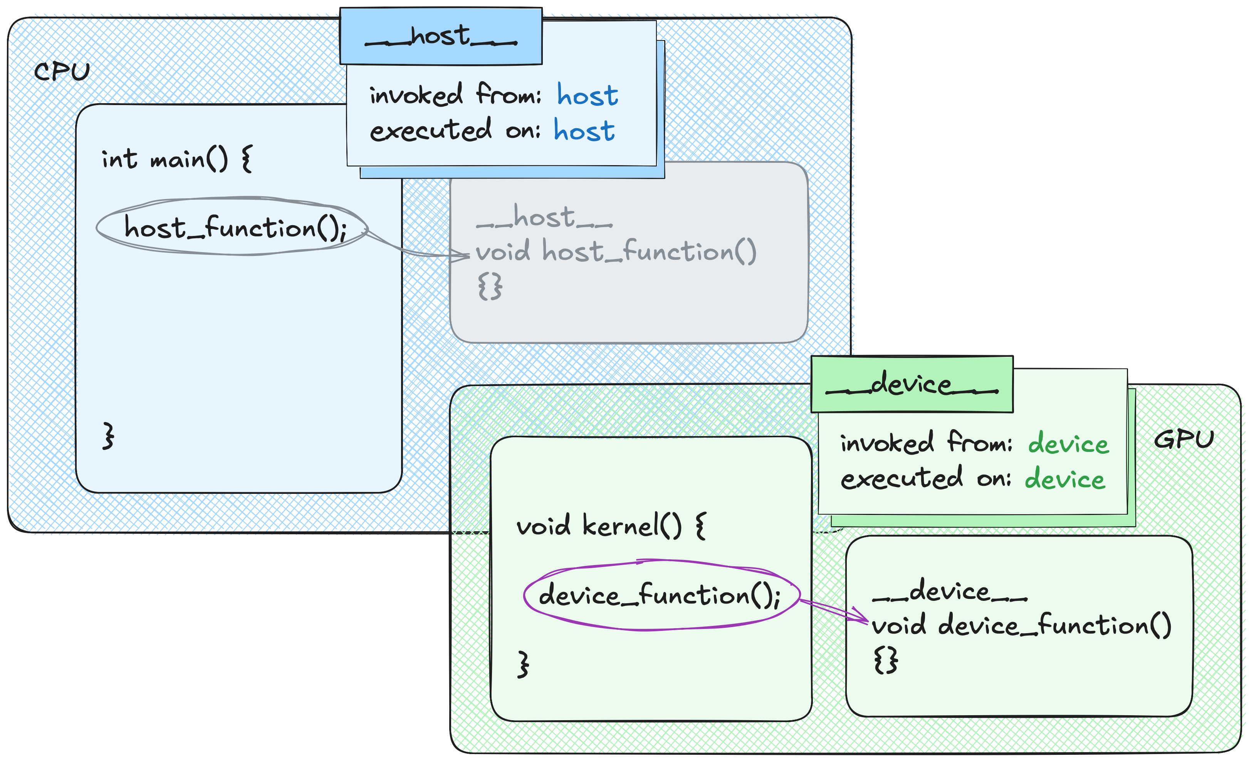
CUDA Kernels
Device functions are:
compiled into GPU instructions
invoked from device
executed on device
Notes:
Similarly, device functions are compiled into GPU instructions, called from the device, and executed on the device.

Slide 6
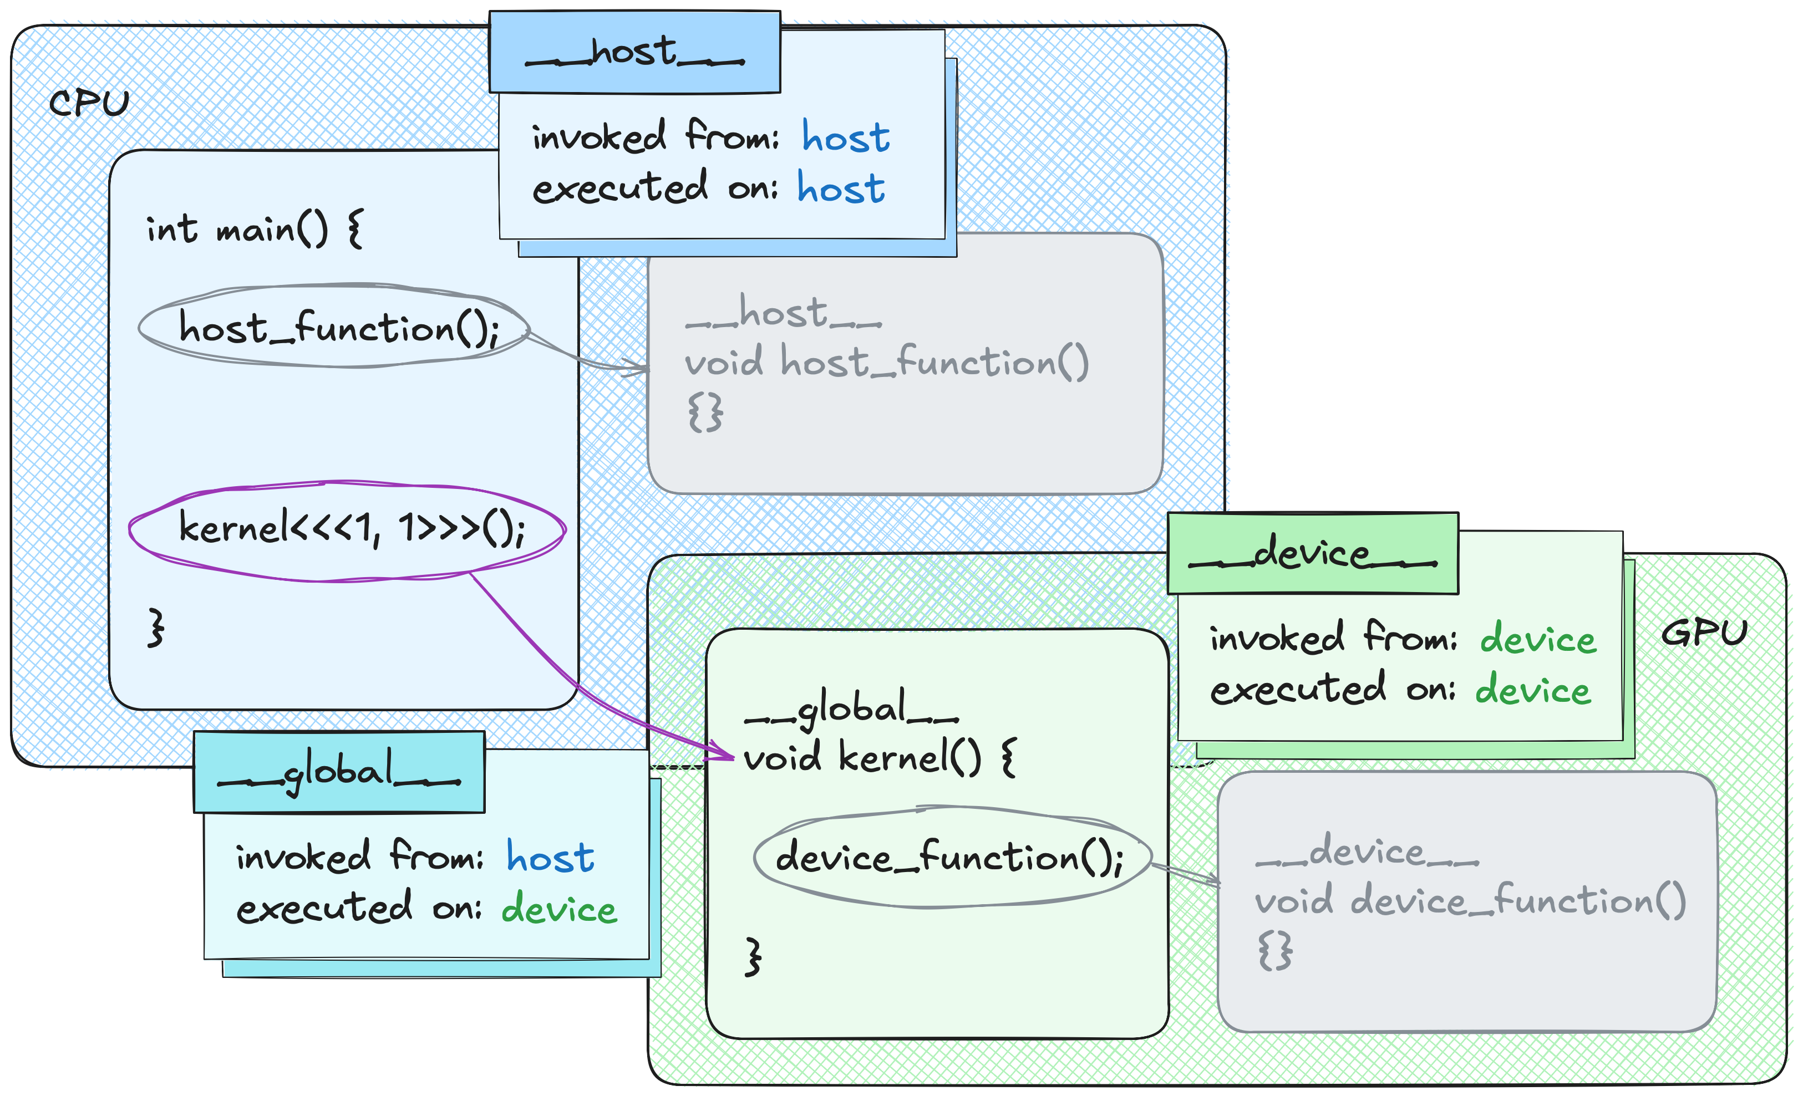
CUDA Kernels
Kernels are:
launched with triple chevron syntax <<<?, ?, ?, stream>>> from CPU
executed in device execution space
asynchronous, and
parallel
Notes:
There’s another annotation we haven’t discussed yet.
When you mark a function with __global__, it’s compiled into GPU instructions and executed on the GPU - but it’s called from the CPU!
These functions are known as CUDA kernels.
Calling a CUDA kernel from the CPU looks unusual because of the triple angle brackets with some numbers inside.
We’ll talk about what those numbers mean later in the course.
Another important detail is that kernel calls are asynchronous: much like calling a CUB algorithm.
The CPU doesn’t wait for the kernel to finish on the GPU.

Slide 7
Current Code
using temperature_grid_f =
cuda::std::mdspan<float, cuda::std::dextents<int, 2>>;
void simulate(temperature_grid_f in,
float *out,
cudaStream_t stream)
{
auto ids = thrust::make_counting_iterator(0);
cub::DeviceTransform::Transform(
ids, out, in.size(),
[in] __host__ __device__(int cell_id) {
return dli::compute(cell_id, in);
}, stream);
}
Currently, the simulator is:
using cuda::std::mdspan to view data as 2D
Using CUB to transform cell indices into the next temperatures
Under the hood, CUB:
invokes kernels on provided stream
doesn’t synchronize the stream,
which makes CUB asynchronous
Let’s try implementing simulator without CUB!
Notes:
Before we start writing our own CUDA kernels, let’s recap how our simulator currently works.
We use an mdspan for a 2D view of the temperature grid.
Then, we transform cell indices into new temperatures with CUB device transform.
Under the hood, CUB implements device transform using CUDA kernels, which is why they run asynchronously.
To see how CUDA kernels actually work, it’s best to start with code we’re already familiar with.
So, let’s try rewriting our simulator to launch kernels directly, rather than relying on CUB.

Slide 8
CUDA Kernels
__global__
void single_thread_kernel(dli::temperature_grid_f in, float *out)
{
for (int id = 0; id < in.size(); id++)
{
out[id] = dli::compute(id, in);
}
}
void simulate(dli::temperature_grid_f in,
float *out,
cudaStream_t stream)
{
single_thread_kernel<<<1, 1, 0, stream>>>(in, out);
}
Triple chevron accepts four parameters:
You know what stream is at this point
we’ll go over remaining parameters one at a time
Notes:
So, let’s do exactly that.
On this slide, you’ll see a simple CUDA kernel that iterates over all cells and transforms their indices into new temperatures.
Notice the triple-chevron syntax when launching it: the fourth parameter is a CUDA stream.
By passing a stream here, we can run this computation asynchronously on the specified stream.

Slide 9
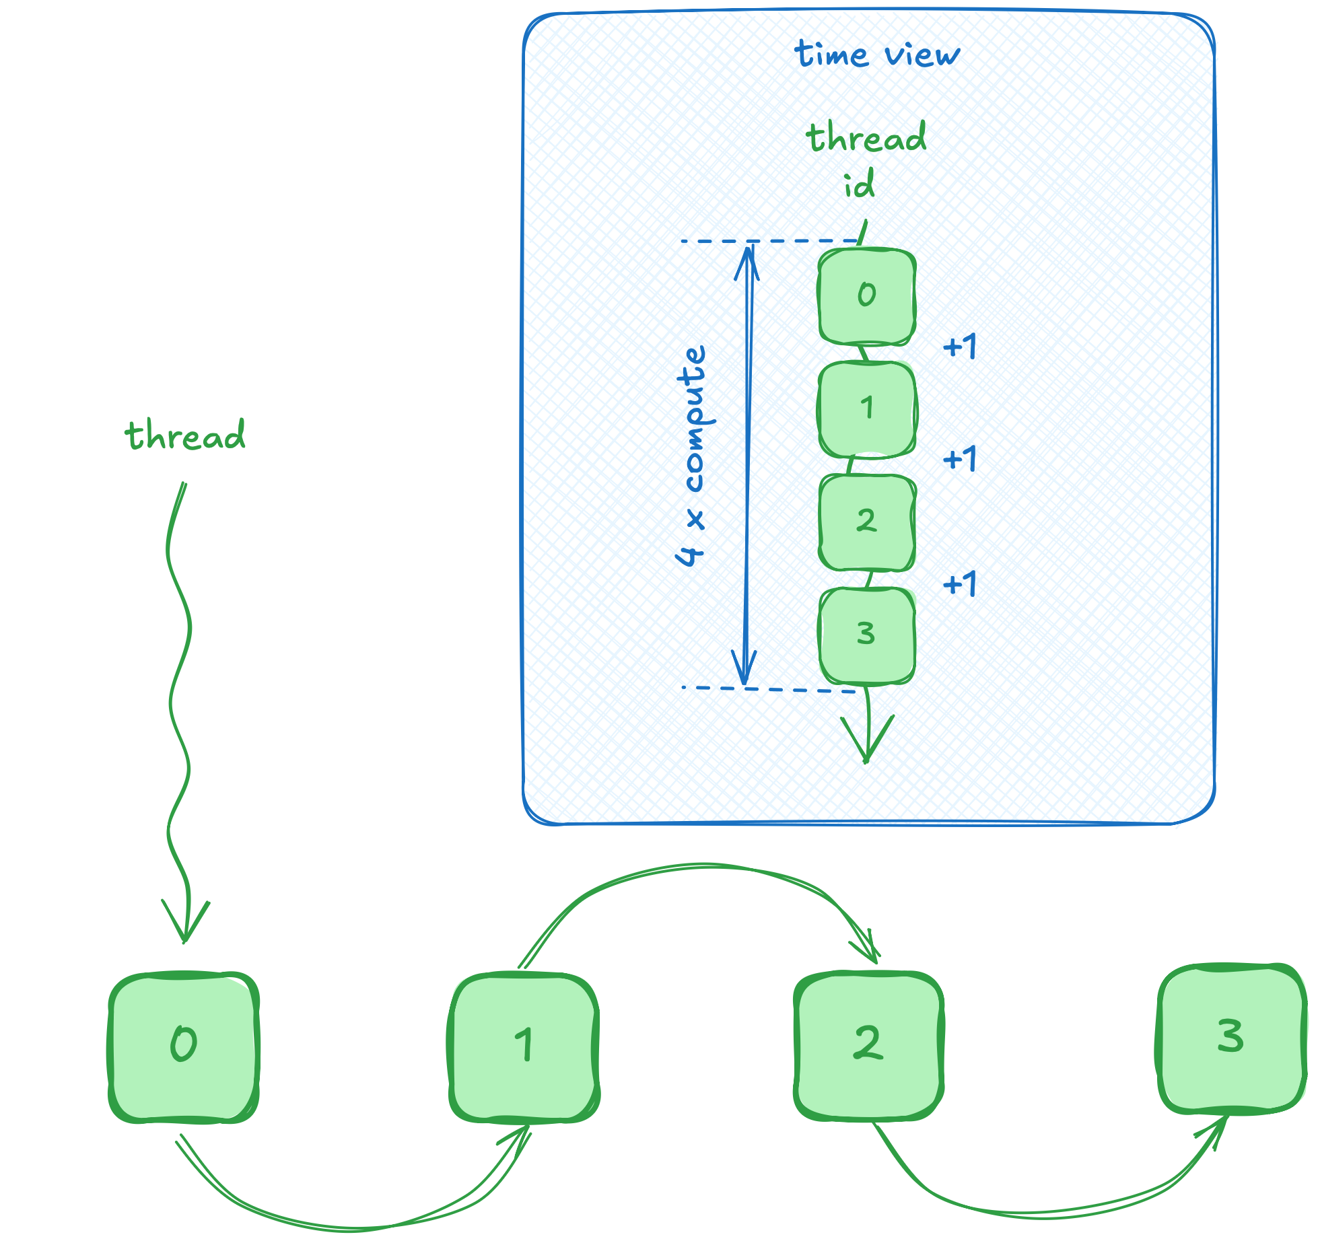
CUDA Kernels
__global__
void single_thread_kernel(dli::temperature_grid_f in, float *out)
{
for (int id = 0; id < in.size(); id++)
{
out[id] = dli::compute(id, in);
}
}
As we saw previously, GPUs do not auto-magically parallelize your code:
Single-threaded code remains serial
This makes our kernel incredibly slow
10 compute steps take:
cub: 0.000043
1 thread: 4.15
Notes:
But as you already know, the GPU doesn’t magically parallelize code on its own!
This means, that a single GPU thread is computing each cell in sequence.
Overall, this makes our kernel roughly ten thousand times slower than CUB.

Slide 10
CUDA Kernels
const int number_of_threads = 2;
__global__
void block_kernel(dli::temperature_grid_f in, float *out)
{
int thread_index = threadIdx.x;
for (int id = thread_index; id < in.size(); id += number_of_threads)
{
out[id] = dli::compute(id, in);
}
}
void simulate(dli::temperature_grid_f in,
float *out,
cudaStream_t stream)
{
block_kernel<<<1, number_of_threads, 0, stream>>>(in, out);
}
10 compute steps take:
cub: 0.000043
1 thread: 4.15
2 threads: 2.6
Notes:
Fortunately, kernels are inherently parallel, so we can increase the number of threads.
For instance, to launch two threads, I pass 2 as the second parameter in the triple-chevron syntax.
You can see on the right that doing so nearly doubles the kernel’s speed.
But simply launching more threads isn’t enough - if they all process the same cells, there’s no actual speedup.
To fix this, we need to modify the kernel so each thread can distinguish itself and handle a different subset of cells.

Slide 11
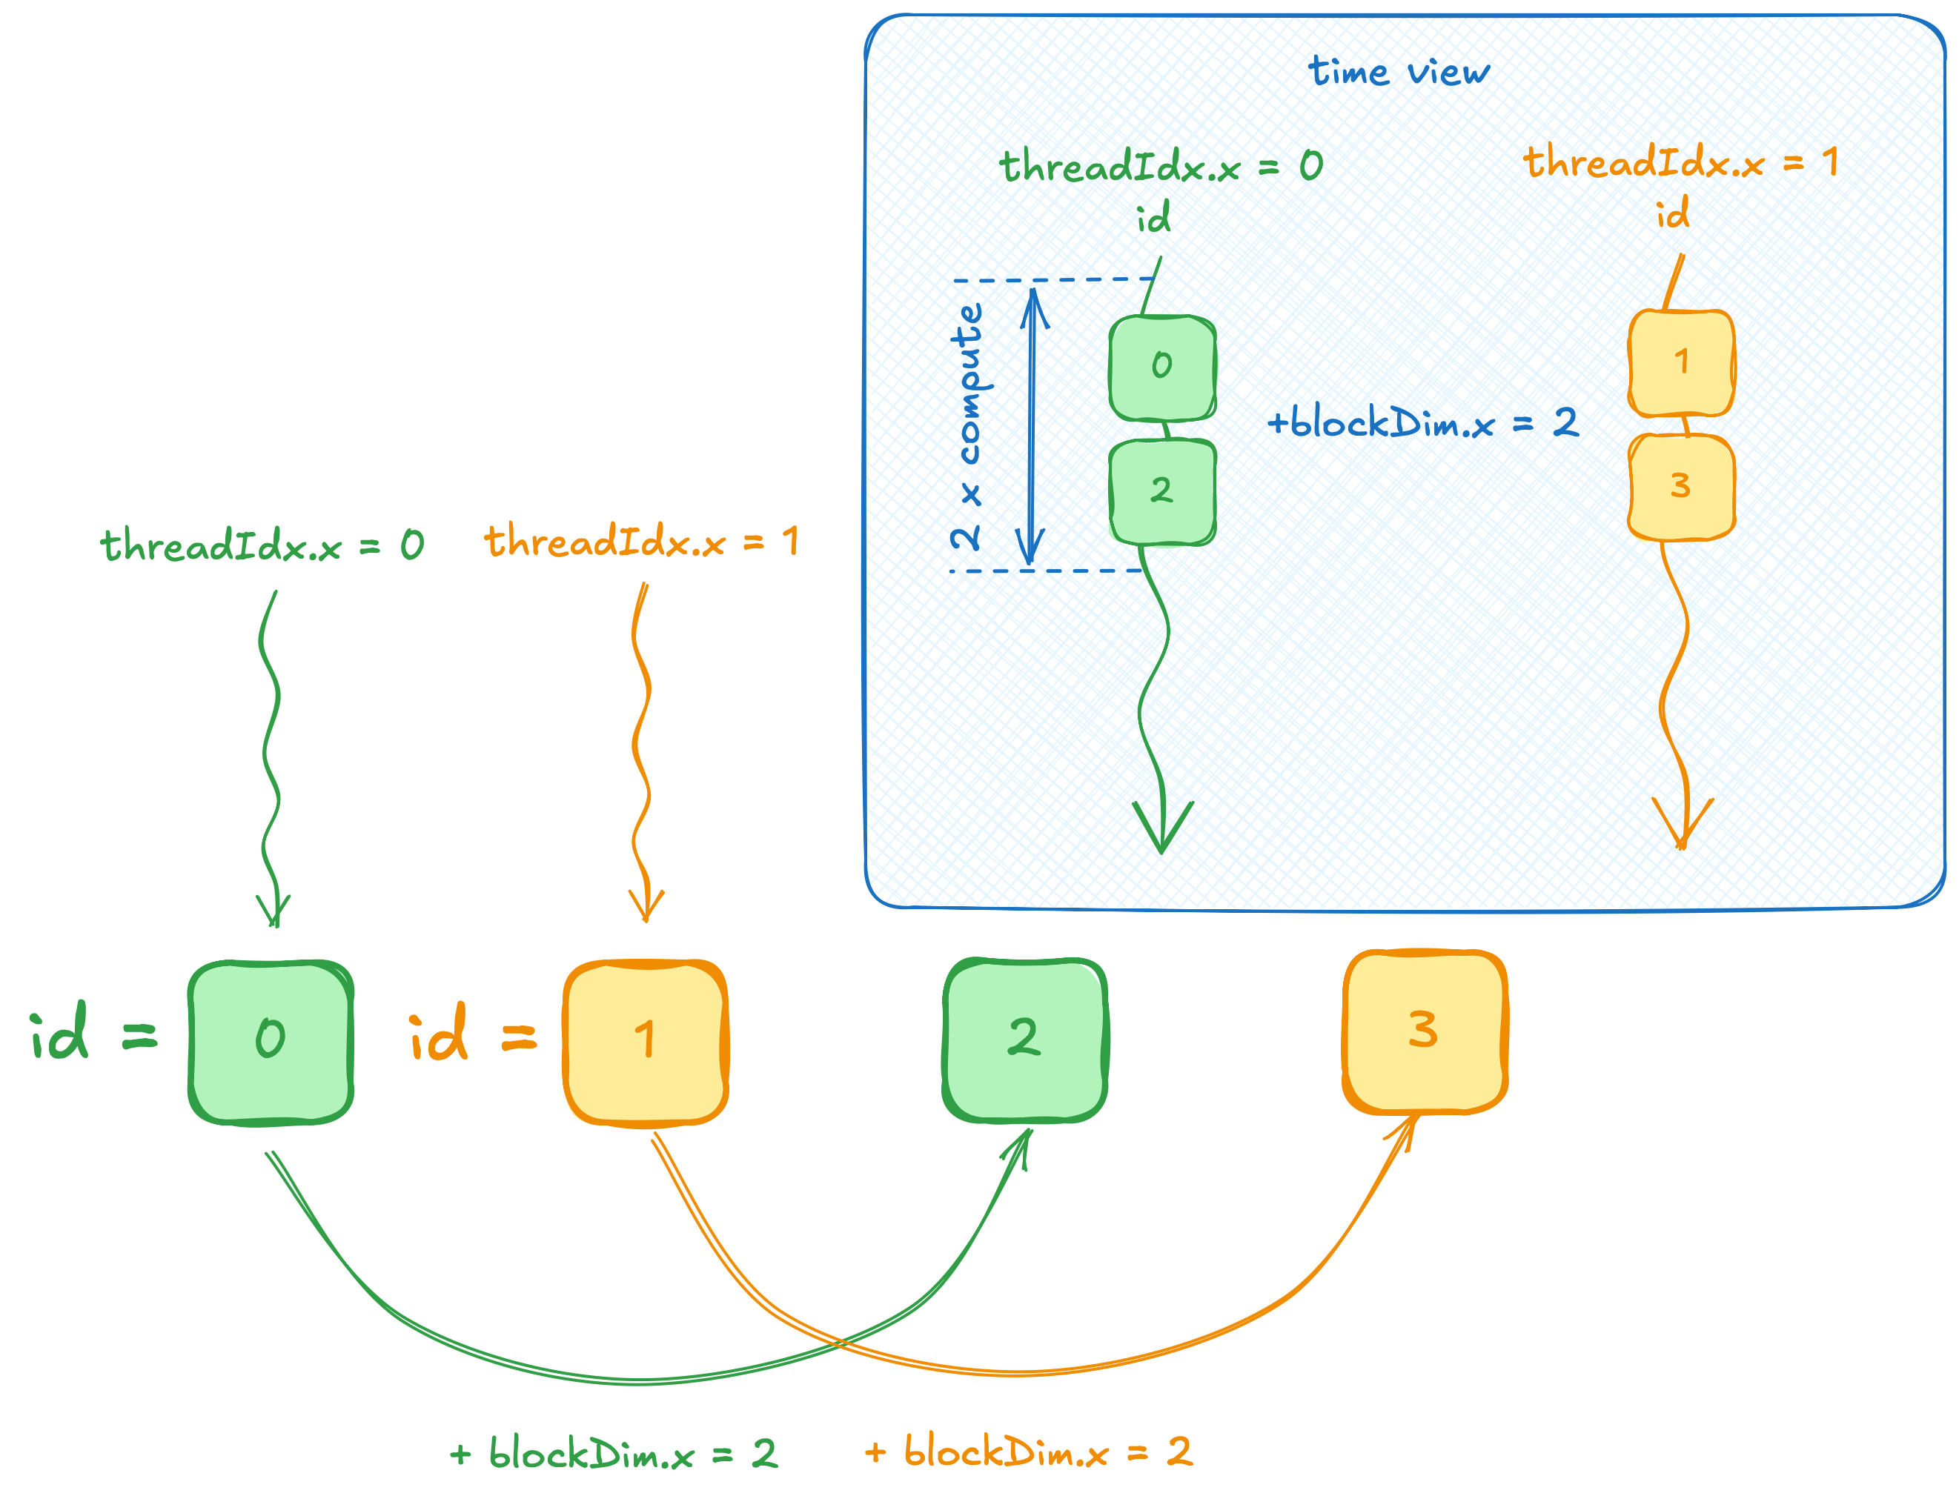
CUDA Kernels
const int number_of_threads = 2;
__global__
void block_kernel(dli::temperature_grid_f in, float *out)
{
int thread_index = threadIdx.x;
for (int id = thread_index; id < in.size(); id += number_of_threads)
{
out[id] = dli::compute(id, in);
}
}
CUDA extends device code with a few variables:
threadIdx.x stores index of the current thread
Notes:
That’s where threadIdx.x comes in.
threadIdx.x is a built-in variable available in CUDA kernels.
It holds the index of the current thread.
So, if we launch two threads, threadIdx.x will be equal to 0 in one thread and 1 in another.

Slide 12
CUDA Kernels
const int number_of_threads = 2;
__global__
void block_kernel(dli::temperature_grid_f in, float *out)
{
int thread_index = threadIdx.x;
for (int id = thread_index; id < in.size(); id += number_of_threads)
{
out[id] = dli::compute(id, in);
}
}
Same kernel is executed by multiple GPU threads
threadIdx.x = 0
threadIdx.x = 1
int thread_index = 0;
out[0] = dli::compute(0, in);
out[2] = dli::compute(2, in);
int thread_index = 1;
out[1] = dli::compute(1, in);
out[3] = dli::compute(3, in);
Notes:
With this approach, each thread processes a different subset of cells.
In the kernel, we first read threadIdx.x to identify the current thread’s index.
Then, each thread starts by processing the cell whose index matches its own thread index.
That means that the first thread works on cell 0, and the second thread works on cell 1.
After finishing one cell, we move ahead by adding the total number of threads to the cell index.
This way, the first thread takes cell 2 next, while the second thread moves on to cell 3, and so on.

Slide 13
CUDA Kernels
const int number_of_threads = 2;
__global__
void block_kernel(dli::temperature_grid_f in, float *out)
{
int thread_index = threadIdx.x;
for (int id = thread_index; id < in.size(); id += number_of_threads)
{
out[id] = dli::compute(id, in);
}
}
CUDA extends device code with a few variables:
threadIdx.x stores index of the current thread
10 compute steps take:
cub: 0.000043
1 thread: 4.15
2 threads: 2.6
Notes:
Notice how this scheme allows us to to compute all cells in parallel such that one cell is never processed by multiple threads.
Another observation is that there’s nothing specific in our code that would limit it to only two threads.
So, let’s try increasing the number of threads working on this CUDA kernel.

Slide 14
CUDA Kernels
const int number_of_threads = 256;
__global__
void block_kernel(dli::temperature_grid_f in, float *out)
{
int thread_index = threadIdx.x;
for (int id = thread_index; id < in.size(); id += number_of_threads)
{
out[id] = dli::compute(id, in);
}
}
void simulate(dli::temperature_grid_f in,
float *out,
cudaStream_t stream)
{
block_kernel<<<1, number_of_threads, 0, stream>>>(in, out);
}
Scheme works!
More threads process input faster
Let’s just keep adding them
10 compute steps take:
cub: 0.000043
1 thread: 4.15
2 threads: 2.6
256 threads: 0.037
Notes:
Here, I’ve increased the number of threads to 256, and this scheme still works great.
Our performance has improved significantly, but we’re still nowhere near CUB’s speed.
Let’s see if adding even more threads can bridge this gap.

Slide 15
CUDA Kernels
const int number_of_threads = 2048;
__global__
void block_kernel(dli::temperature_grid_f in, float *out)
{
int thread_index = threadIdx.x;
for (int id = thread_index; id < in.size(); id += number_of_threads)
{
out[id] = dli::compute(id, in);
}
}
void simulate(dli::temperature_grid_f in,
float *out,
cudaStream_t stream)
{
block_kernel<<<1, number_of_threads, 0, stream>>>(in, out);
}
The error is expected:
You cannot launch more than 1024 threads
… in a thread block, which is a HW limit
terminate called after throwing an instance of 'std::runtime_error'
what(): invalid configuration argument
Notes:
Now I’ve tried launching 2048 threads, and suddenly everything fails with a cryptic ‘invalid configuration argument’ error.
As usual, this means there’s a gap in our understanding.
It turns out that there’s a limit on the number of threads.. in a single block.
So, what exactly is a thread block, and why does it matter for our kernel launch?

Slide 16
Missing Context
threads are grouped in blocks
all blocks are of the same size (max 1024 threads)
thread indexing is local within a thread block
collection of blocks is called grid
blockIdx.x stores index of current block within grid
blockDim.x stores the number of threads in the block
gridDim.x stores the number of blocks in the grid
Notes:
In CUDA, threads are grouped into blocks, and the entire collection of these blocks is called a grid.
As we’ve seen already, each block can contain up to 1024 threads, and every block in a single kernel launch has the same size.
The threadIdx.x variable we’ve seen so far stores the thread’s local index within its block.
For example, if we have three blocks, each block will have a thread with threadIdx.x set to 0, and another thread with threadIdx.x set to 1/
That means we end up with three threads labeled 0, three labeled 1, and so forth.
And just as we used threadIdx.x to distinguish threads within a block, we also need a way to identify which block we’re in.
To do that, CUDA provides additional built-in variables.

Slide 17
CUDA Kernels
collection of blocks is called grid
blockIdx.x stores index of current block within grid
blockDim.x stores the number of threads in the block
gridDim.x stores the number of blocks in the grid
__global__
void grid_kernel(...)
{
int number_of_threads = blockDim.x * gridDim.x;
...
Notes:
blockDim.x tells us how many threads are there in each block.
In the example on the slide, every thread sees 2 for blockDim.x.
Meanwhile, gridDim.x gives the number of blocks in the grid.
So, if gridDim.x is 3, that means there are 3 blocks total.
By multiplying blockDim.x by gridDim.x we can get the total number of threads in the grid.
For the example on the slide, 2 * 3 gives us 6 threads in total.

Slide 18
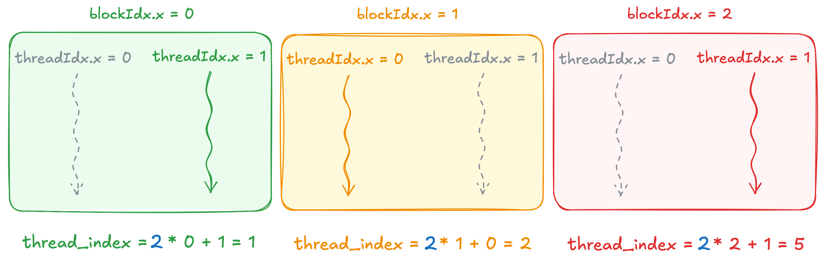
CUDA Kernels
collection of blocks is called grid
blockIdx.x stores index of current block within grid
blockDim.x stores the number of threads in the block
gridDim.x stores the number of blocks in the grid
__global__
void grid_kernel(...)
{
int thread_index = blockDim.x * blockIdx.x
+ threadIdx.x;
...
Notes:
Besides knowing the total number of threads, we also need each thread’s unique index across the entire grid.
For that, we use another built-in variable, called blockIdx.x, which holds the block’s index within the grid.
All threads in block 0 see blockIdx.x = 0 while all threads in block 1 see 1, and so on.
To calculate a thread’s global index, we multiply blockIdx.x by blockDim.x to find out how many threads are there before the current block.
Then we add threadIdx.x, which is the thread’s local index in its block.
For example, the second thread of the first block multiplies 2 by 0, then adds 1 for its local index, giving a global index of 1.
Same computation results in index 5 for the last thread of the last block.

Slide 19
Which Block Size to Use?
Thread block size doesn’t depend on problem size
There’s no block size that fits all the kernels
As a rule of thumb:
Use block sizes that are multiple of 32
Use 256 as a good default
Profile for further tuning
void simulate(dli::temperature_grid_f in,
float *out,
cudaStream_t stream)
{
int block_size = 256;
...
grid_kernel<<<grid_size, block_size, 0, stream>>>(in, out);
}
Notes:
So now we know how to find each thread’s unique index within the grid, and we also know the total number of threads.
But a few questions remain.
For example, what block size should we use?
Unfortunately, there’s no one-size-fits-all answer.
This often comes down to optimization.
One helpful guideline is to pick block sizes in multiples of 32, because of how the GPU hardware groups threads.
A common default is 256 threads per block, which we’ll use throughout this course.

Slide 20
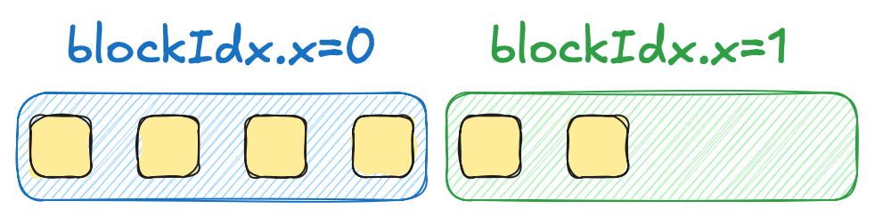
Which Grid Size to Use?
We need the number number of thread blocks (grid size)
Grid size frequently depend on problem size
As a rule of thumb, use cuda::ceil_div to compute grid size
void simulate(dli::temperature_grid_f in,
float *out,
cudaStream_t stream)
{
int block_size = 256;
int grid_size = cuda::ceil_div(in.size(), block_size);
grid_kernel<<<grid_size, block_size, 0, stream>>>(in, out);
}
int ceil_div(int a, int b)
{
return (a + b - 1) / b;
}
Notes:
The second question is how many blocks we should launch.
Because we typically want to maximize parallelism, the grid size often depends on the problem size.
For example, if we want each thread to handle exactly one element, a simple integer division won’t work.
Imagine that we have 6 cells to process and choose a block size of 4 threads.
If we divide 6 by 4, we get 1, which means only one block is launched and some threads end up with extra cells.
Instead, we can use `cuda::ceil_div` to perform an integer division that rounds up.
Applying cuda::ceil_div gives us 2, ensuring enough blocks so each thread processes exactly one cell.
To specify that we want two thread blocks, it’s sufficient to pass two as the first parameter of the triple chevron.

Slide 21
CUDA Kernels
__global__
void grid_kernel(dli::temperature_grid_f in, float *out)
{
int thread_index = blockDim.x * blockIdx.x + threadIdx.x;
int number_of_threads = blockDim.x * gridDim.x;
for (int id = thread_index; id < in.size(); id += number_of_threads)
{
out[id] = dli::compute(id, in);
}
}
void simulate(dli::temperature_grid_f in,
float *out,
cudaStream_t stream)
{
int block_size = 256;
int grid_size = cuda::ceil_div(in.size(), block_size);
grid_kernel<<<grid_size, block_size, 0, stream>>>(in, out);
}
10 compute steps take:
cub: 0.000043
1 thread: 4.15
2 threads: 2.6
256 threads: 0.037
5’120’000 threads: 0.0003
Notes:
With these changes, we’re now launching around five million threads and finally getting close to CUB’s performance.
Of course, CUB still has more advanced optimizations under the hood, so fully matching its speed is unlikely.
But for such a simple kernel, this is already a significant improvement.

Slide 22
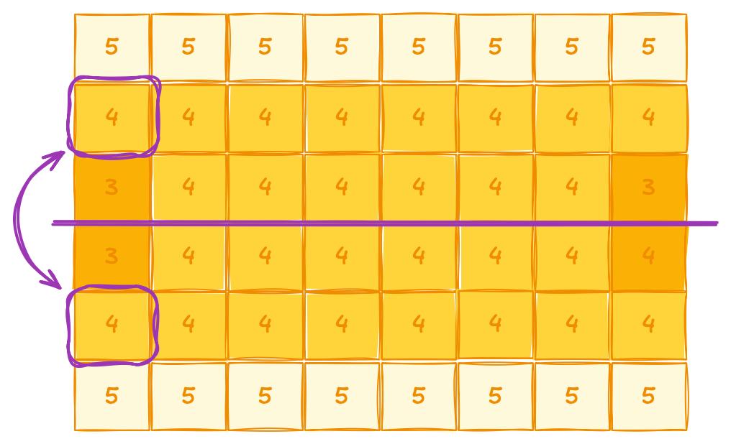
Exercise: Detect Asymmetry
5 minutes
Boundary conditions are symmetric
Remaining cells should be symmetric as well
Rewrite the function below as a kernel to verify that
void symmetry_check(dli::temperature_grid_f temp, int row)
{
int column = 0;
float top = temp(row, column);
float bottom = temp(temp.extent(0) - 1 - row, column);
float diff = abs(top - bottom);
if (diff > 0.1) {
printf("Error: asymmetry in %d\n", column);
}
}
03.02-Kernels/03.02.02-Exercise-Symmetry.ipynb
Notes:
We’ve modified our simulator but haven’t yet confirmed that it still works correctly.
Because our setup is symmetric - temperatures at the top and bottom of the grid are identical.
So, we can do a quick ‘smoke test’ by checking that symmetry.
The idea is simple: for a given cell, we find its mirrored row by subtracting row’s index from the grid’s height.
If everything is correct, temperatures of these symmetric cells should be nearly the same.
On the screen, you’ll see a C++ function that performs this check.
As part of this exercise, you’ll have to turn this function into a CUDA kernel and launch it with the triple-chevron syntax.
For this you have 5 minutes starting now.

Slide 23
Exercise: Detect Asymmetry
Solution
__global__
void symmetry_check_kernel(dli::temperature_grid_f temp, int row)
{
int column = 0;
float top = temp(row, column);
float bottom = temp(temp.extent(0) - 1 - row, column);
float diff = abs(top - bottom);
if (diff > 0.1) {
printf("Error: asymmetry in %d\n", column);
}
}
void symmetry_check(dli::temperature_grid_f temp, cudaStream_t stream)
{
int target_row = 0;
symmetry_check_kernel<<<1, 1, 0, stream>>>(temp, target_row);
}
Annotate function with __global__ specifier
03.02-Kernels/03.02.02-Exercise-Symmetry.ipynb
Notes:
Time’s up!
To turn the symmetry-check function into a CUDA kernel, we have to annotate it with __global__ specifier.

Slide 24
Exercise: Detect Asymmetry
Solution
__global__
void symmetry_check_kernel(dli::temperature_grid_f temp, int row)
{
int column = 0;
float top = temp(row, column);
float bottom = temp(temp.extent(0) - 1 - row, column);
float diff = abs(top - bottom);
if (diff > 0.1) {
printf("Error: asymmetry in %d\n", column);
}
}
void symmetry_check(dli::temperature_grid_f temp, cudaStream_t stream)
{
int target_row = 0;
symmetry_check_kernel<<<1, 1, 0, stream>>>(temp, target_row);
}
Use triple chevron to launch the kernel
03.02-Kernels/03.02.02-Exercise-Symmetry.ipynb
Notes:
After that, we need to launch it using the triple-chevron syntax.
Because there’s no real parallel work here, we’ll launch just a single block with a single thread.
To make sure this check runs on the correct stream, we specify the stream as the last parameter in the triple-chevron.

Slide 25
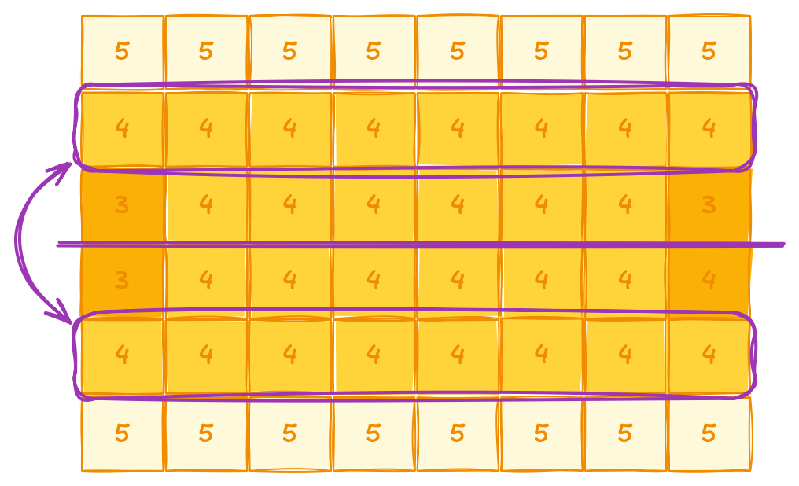
Exercise: Detect Row Asymmetry
8 minutes
Entire row should be symmetric, not just one cell
Rewrite the kernel below to verify that it’s the case
Assign each thread to verify exactly one column
__global__
void symmetry_check(dli::temperature_grid_f temp, int row)
{
int column = 0;
float top = temp(row, column);
float bottom = temp(temp.extent(0) - 1 - row, column);
float diff = abs(top - bottom);
if (diff > 0.1) {
printf("Error: asymmetry in %d\n", column);
}
}
03.02-Kernels/03.02.03-Exercise-Row-Symmetry.ipynb
Notes:
Now, when you think about it, the entire row should be symmetrical, not just a single cell!
In this exercise, you’ll modify the kernel so that each thread handles exactly one column.
For this exercise, you’ll have 8 minutes starting now.

Slide 26
Exercise: Detect Row Asymmetry
Solution
__global__ void row_symmetry_check_kernel(dli::temperature_grid_f temp, int row)
{
int column = blockIdx.x * blockDim.x + threadIdx.x;
if (abs(temp(row, column) - temp(temp.extent(0) - 1 - row, column)) > 0.1)
{
printf("Error: asymmetry in %d / %d\n", column, temp.extent(1));
}
}
void symmetry_check(dli::temperature_grid_f temp, cudaStream_t stream)
{
int width = temp.extent(1);
int block_size = 256;
int grid_size = cuda::ceil_div(width, block_size);
int target_row = 0;
row_symmetry_check_kernel<<<grid_size, block_size, 0, stream>>>(temp, target_row);
}
03.02-Kernels/03.02.03-Exercise-Row-Symmetry.ipynb
Notes:
Time’s up!
As before, we use the block and thread indices to compute each thread’s global index within the grid. Then, we calculate the necessary grid size with cuda::ceil_div and plug that into our triple-chevron launch.
This way, each thread handles exactly one column, and the entire row is checked in parallel.

Slide 27
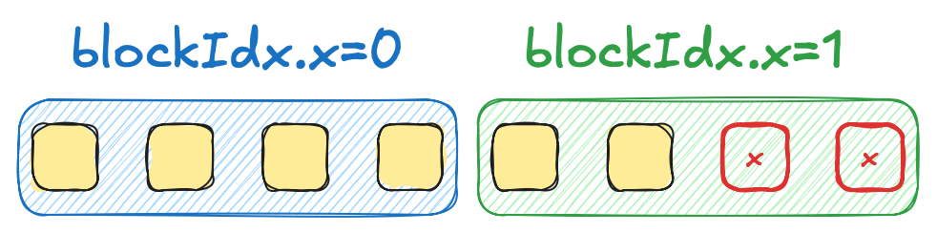
Exercise: Detect Row Asymmetry
Bug in the solution
__global__ void symmetry_check_kernel(dli::temperature_grid_f temp, int row)
{
int column = blockIdx.x * blockDim.x + threadIdx.x;
V
int width = temp.extent(1);
int block_size = 1024;
int grid_size = cuda::ceil_div(width, block_size);
int target_row = 0;
symmetry_check_kernel<<<grid_size, block_size, 0, stream>>>(temp, target_row);
}
03.02-Kernels/03.02.03-Exercise-Row-Symmetry.ipynb
Notes:
And… we’ve just caused our first out-of-bounds access!
Because we round up to make sure that each thread has at least one element, we might launch more threads than the actual problem size.
In the case of six elements and two blocks of four threads, two last threads will access indices 6 and 7, which are out of range.

Slide 28
Fixed Row Symmetry Check
__global__ void symmetry_check_kernel(dli::temperature_grid_f temp, int row)
{
int column = blockIdx.x * blockDim.x + threadIdx.x;
if (column < temp.extent(1))
{
if (abs(temp(row, column) - temp(temp.extent(0) - 1 - row, column)) > 0.1)
{
printf("Error: asymmetry in %d / %d\n", column, temp.extent(1));
}
}
}
Check if a given thread is within bounds of problem size
Notes:
We can fix this by adding a boundary check in the kernel.
Specifically, after computing the global thread index, we compare it against the total number of columns and skip any work if it’s outside of the valid range.
But how would you discover the source of this out-of-bounds access on your own?

Slide 29
Compute Sanitizer
nvcc --extended-lambda -g -G -o /tmp/a.out ./src/row_symmetry_check.cu
compute-sanitizer /tmp/a.out
========= Invalid __global__ read of size 4 bytes
========= at symmetry_check_kernel(cuda::std::mdspan<>, int) in row_symmetry_check.cu:7
========= by thread (905,0,0) in block (4,0,0)
========= Address 0x7c5287588004 is out of bounds
========= and is 5 bytes after the nearest allocation at 0x7c5286200000 of size 20,480,000 bytes
========= Saved host backtrace up to driver entry point at kernel launch time
__global__ void symmetry_check_kernel(dli::temperature_grid_f temp, int row)
{
int column = blockIdx.x * blockDim.x + threadIdx.x;
if (abs(temp(row, column) - temp(temp.extent(0) - 1 - row, column)) > 0.1)
{
printf("Error: asymmetry in %d / %d\n", column, temp.extent(1));
}
}
One way to detect the bug would be compute sanitizer
Notes:
NVIDIA provides a special tool called compute-sanitizer that helps detect out-of-bounds accesses and other memory issues in your CUDA kernels.
If you compile the simulator with the flags shown on the slide and then run it through compute-sanitizer, it will pinpoint the exact line where the illegal access occurs.
You’ll see messages like “invalid read of size 4 bytes in line 7,” which make debugging kernels much simpler.
However, there’s also another way to spot this issue…

Slide 30
Assertions
#define CCCL_ENABLE_ASSERTIONS
#include <cuda/std/mdspan>
__global__ void row_symmetry_check_kernel(dli::temperature_grid_f temp, int row)
{
int column = blockIdx.x * blockDim.x + threadIdx.x;
if (abs(temp(row, column) - temp(temp.extent(0) - 1 - row, column)) > 0.1)
{
printf("Error: asymmetry in %d / %d\n", column, temp.extent(1));
}
}
Another way to detect the bug would be enabling assertions
Runtime checks affect performance, so OOB access checks are disable by default
You could enable them by defining CCCL_ENABLE_ASSERTIONS before including any header in debug
mdspan.h:134: __index: block: [0,0,0], thread: [3,0,0] Assertion `cuda::std::mdspan subscript out of range!` failed.
Notes:
[optional – if time permits]
mdspan can actually detect out-of-bounds access on its own, though this feature is off by default to preserve performance.
If you define the CCCL_ENABLE_ASSERTIONS macro before including mdspan, it will begin checking all indices.
Then, if any out-of-bounds access occurs, mdspan will print an error message like the one you see on the screen.

Slide 31
Why Thread Hierarchy?
We just fixed a bug caused by splitting grid into blocks
It’s reasonable to ask a question: why adding all this complexity with thread hierarchy?
Notes:
We’ve just fixed a bug caused by splitting threads into blocks.
It’s only natural to ask: why having all this complexity with thread hierarchy in the first place?
To find out, let’s modify our problem a bit to see where thread blocks truly make a difference.

Slide 32
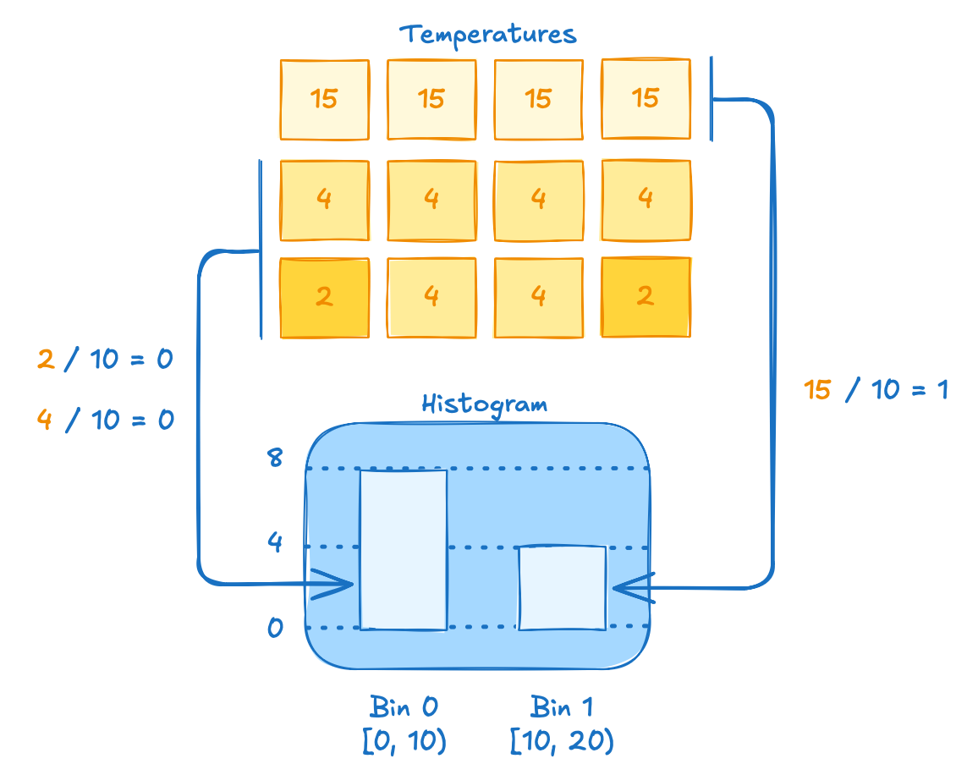
Histogram
Histogram groups data into bins by counting how many values fall into each bin
For our case, it shows overall distribution of temperatures
Each bin covers a temperature range, and the bar height shows how many cells lie in that range
Notes:
Let’s now create a histogram for the temperatures that our simulator produces.
A histogram helps us see how frequently certain temperature ranges occur, so let’s quickly review how it works.
First, we divide the entire temperature range into bins, each covering the same span - in our case, 10 degrees.
For each cell in the simulation, we determine which bin its temperature falls into.
A simple way to do this is to divide the temperature by the bin width and round down.
For example, if a cell’s temperature is 4 degrees, we divide by 10 and get 0, which corresponds to the first bin.
If a cell’s temperature is 15 degrees, dividing by 10 gives us 1, meaning it goes into the second bin.
Once we’ve assigned each cell to the correct bin, we count how many cells landed in each bin.
That count becomes the height of the bar in the histogram.
In our example, eight cells fall into the first bin and four cells into the second bin.
This final visual makes it easy to spot patterns and see which temperature ranges are most common in the simulation.

Slide 33
span
cuda::std::span is like one-dimensional cuda::std::mdspan
__global__ void histogram_kernel(
cuda::std::span<float> temperatures,
cuda::std::span<int> histogram)
{
...
Includes size information
Safer alternative to raw pointers
Reducing common pointer errors
Lightweight view over a sequence
Does not own the data, just references it
Notes:
Let’s begin by writing our kernel signature.
Since our histogram only needs one dimension, mdspan would be an overkill.
Instead, we can use span, which is essentially a one-dimensional mdspan.
In CUDA, just like in C++, span is preferred over raw pointers because it’s safer, helps prevent common pointer errors, while remaining lightweight.

Slide 34
Interface
cuda::std::array<int, 4> a{1, 2, 3, 4};
cuda::std::span<int> span(a.data(), 3);
std::printf("span[0] = %d\n", span[0]); // 1
std::printf("span[1] = %d\n", span[1]); // 2
std::printf("span.size() = %zu\n", span.size()); // 3
constructor takes pointer and size
Notes:
To construct a span, it’s sufficient to pass it a raw pointer and a size.

Slide 35
Interface Recap
cuda::std::array<int, 4> a{1, 2, 3, 4};
cuda::std::span<int> span(a.data(), 3);
std::printf("span[0] = %d\n", span[0]); // 1
std::printf("span[1] = %d\n", span[1]); // 2
std::printf("span.size() = %zu\n", span.size()); // 3
provides subscript operator to access elements
Notes:
Then, we can use square brackets to access underlying elements.

Slide 36
Interface
cuda::std::array<int, 4> a{1, 2, 3, 4};
cuda::std::span<int> span(a.data(), 3);
std::printf("span[0] = %d\n", span[0]); // 1
std::printf("span[1] = %d\n", span[1]); // 2
std::printf("span.size() = %zu\n", span.size()); // 3
returns the number of elements in the span
Notes:
Span also provides a size() member function, which returns the total number of elements in the span.

Slide 37
First Attempt at Implementing Histogram Kernel
__global__ void histogram_kernel(
cuda::std::span<float> temperatures,
cuda::std::span<int> histogram)
{
int cell = blockIdx.x * blockDim.x + threadIdx.x;
each thread bins exactly one cell
Notes:
With both the temperatures and histogram passed into our kernel,
we’ll use already familiar thread-index computation scheme to assign exactly one cell per each thread

Slide 38
First Attempt at Implementing Histogram Kernel
constexpr float bin_width = 10;
__global__ void histogram_kernel(
cuda::std::span<float> temperatures,
cuda::std::span<int> histogram)
{
int cell = blockIdx.x * blockDim.x + threadIdx.x;
int bin = static_cast<int>(temperatures[cell] / bin_width);
divide temperature by bin width (10 degrees) to compute the bin index
⚠
In production code, you should check if cell index is within bounds
We’ll omit this check for simplicity and make sure input is multiple of block size
Notes:
Next, each thread loads its corresponding temperature value and divides it by the bin width to find the correct bin index.
In a production environment, you’d also want to ensure that this memory access within bounds.
For simplicity in the slides, we’ll skip the boundary check and rely on problem sizes that are multiples of the block size instead.

Slide 39
First Attempt at Implementing Histogram Kernel
__global__ void histogram_kernel(
cuda::std::span<float> temperatures,
cuda::std::span<int> histogram)
{
int cell = blockIdx.x * blockDim.x + threadIdx.x;
int bin = static_cast<int>(temperatures[cell] / bin_width);
int old_count = histogram[bin];
int new_count = old_count + 1;
histogram[bin] = new_count;
}
Read old value of selected bin
Modify the value we just read (increment)
Write modified value back into memory
Notes:
Next, each thread reads the current count from its assigned bin, increments that value, and writes it back into the histogram.

Slide 40
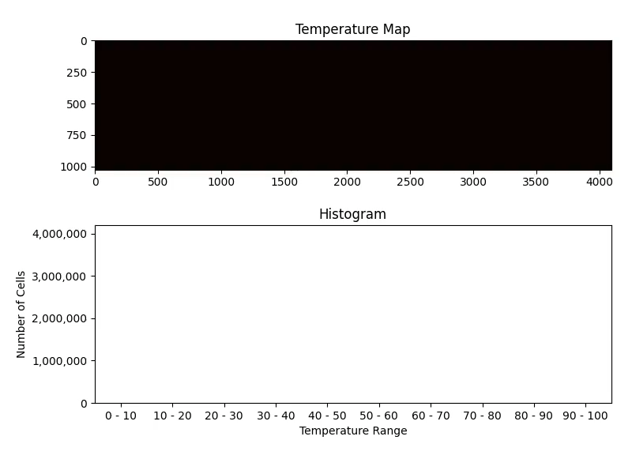
Something Went Wrong
We have about 4M cells
We should see bars adding up to 4M
But resulting histogram looks empty
What happened?
Notes:
But it looks like something went wrong.
We have around four million cells in the grid, so we’d expect the histogram bars to sum to four million.
But the histogram look empty.
What happened?

Slide 41
Source of the Data Race
__global__ void histogram_kernel(
cuda::std::span<float> temperatures,
cuda::std::span<int> histogram)
{
int cell = blockIdx.x * blockDim.x + threadIdx.x;
int bin = static_cast<int>(temperatures[cell] / bin_width);
int old_count = histogram[bin];
int new_count = old_count + 1;
histogram[bin] = new_count;
}
Our kernel has a data race in it
Millions of threads read and write the same memory location!
Notes:
The issue is that our kernel has a data race in the highlighted lines of code.
All those millions of threads are reading and writing the same memory location.
Let’s break this down

Slide 42
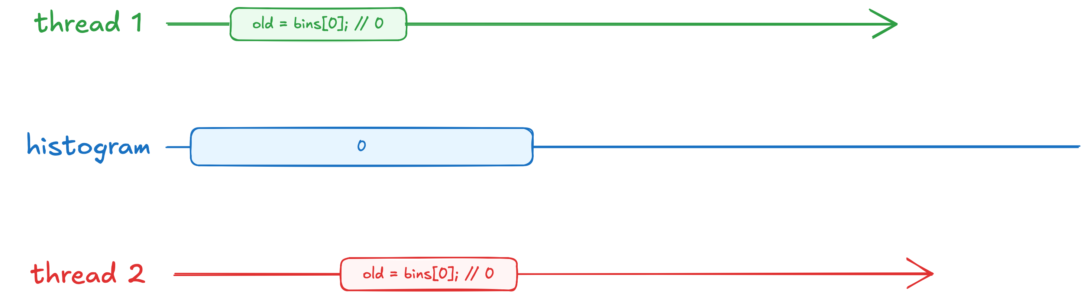


Source of the Data Race
Notes:
Say we have only two threads.
They start by issuing a memory read request.

Slide 43

Source of the Data Race
Notes:
Let’s say memory read from the first thread arrives first.

Slide 44

Source of the Data Race
Notes:
Then memory responds with the current value stored in the histogram, which is zero.

Slide 45
Source of the Data Race
Notes:
Now old counter stores zero.

Slide 46

Source of the Data Race
Notes:
Then, first thread increments zero.
New value stores 1.

Slide 47
Source of the Data Race
Notes:
All while the second thread starts reading zero from memory

Slide 48
Source of the Data Race
Notes:
Now second thread’s local variable stores zero as well

Slide 49



Source of the Data Race
Notes:
Second thread then increments its local counter, while first thread starts writing new value in memory

Slide 50

Source of the Data Race
Notes:
This write overwrites previous value in the histogram, which now stores one

Slide 51

Source of the Data Race
Notes:
But the second thread is doing the same

Slide 52
Source of the Data Race
Notes:
So, in our kernel, we lose most of the increments.
Now imagine this happening with millions of threads and it should make it clear why our final histogram appeared empty.
We simply lost most of the counters because of this data race.

Slide 53
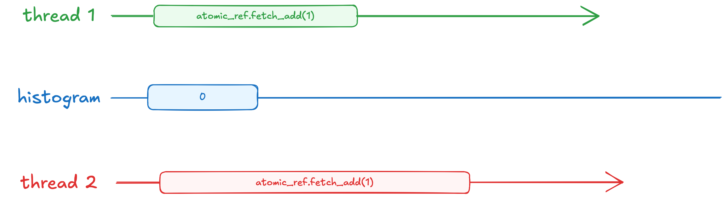

Atomic Memory Operations
To fix data race, we have to make 1. read 2. modify 3. write steps appear as a single indivisible read-modify-write operation
int old_count = histogram[bin];
int new_count = old_count + 1;
histogram[bin] = new_count;
histogram[bin].fetch_add(1);
Notes:
To fix this race, we need to ensure the read–modify–write sequence is treated as a single, indivisible memory operation.
In C++, these operations are known as atomics.
You can think of an atomic as ‘storing’ the instruction itself rather than just bytes.
In the example on the right, we store “+1” into memory, and when that operation arrives on memory, it reads the current value, increments it, and writes back the result in one step - preventing any other thread from interfering in the meantime.

Slide 54
Atomic Memory Operations
cuda::std::atomic_ref<int> ref(count[0]);
ref.fetch_add(3);
ref.fetch_sub(2);
ref.fetch_and(1);
...
Atomics memory operations are indivisible
atomic_ref applies atomic operations to the object it references
For our example, atomic increment appears as indivisible read-modify-write operation
Notes:
CUDA provides a type called cuda::std::atomic_ref, which lets you treat any existing memory location as an atomic variable.
Here, we create an atomic reference to count[0] by wrapping it into atomic reference.
Which then provides us with various atomic function available on this reference.
For instance, we can atomically add or subtract a value from this memory location.
And each of these operations appear as a single, indivisible step to all threads.
Let’s see how this type can help fix our kernel.

Slide 55
Atomic Memory Operations
Notes:
Now both threads issue atomic increment.

Slide 56
Atomic Memory Operations
Notes:
First thread’s fetch add arrives first.

Slide 57
Atomic Memory Operations
Notes:
The question mark in the atomic operation is replaced with current value of the bin

Slide 58
Atomic Memory Operations
Notes:
Then it adds one, and stores result back into memory.
Now our histogram stores 1.

Slide 59
Atomic Memory Operations
Notes:
Second thread’s atomic increment arrives second.

Slide 60

Atomic Memory Operations
Notes:
And now it’s question mark is replaced with current value of the histogram, which ends up being 1.

Slide 61

Atomic Memory Operations
Notes:
Now we add one to one, and store two back into memory.
And as you can see, the memory now stores current result, no increment is lost.

Slide 62
Exercise: Fix Histogram
5 minutes
Use atomics to fix data race in histogram
__global__ void histogram_kernel(
cuda::std::span<float> temperatures,
cuda::std::span<int> histogram)
{
int cell = blockIdx.x * blockDim.x + threadIdx.x;
int bin = static_cast<int>(temperatures[cell] / bin_width);
int old_count = histogram[bin];
int new_count = old_count + 1;
histogram[bin] = new_count;
}
03.03-Atomics/03.03.02-Exercise-Fix-Histogram.ipynb
Notes:
In this exercise you’ll have to fix the data race in the histogram kernel by using atomic references.
For this, you’ll have 5 minutes starting now.

Slide 63
Exercise: Fix Histogram
Solution
Use atomics to fix data race in histogram
__global__ void histogram_kernel(
cuda::std::span<float> temperatures,
cuda::std::span<int> histogram)
{
int cell = blockIdx.x * blockDim.x + threadIdx.x;
int bin = static_cast<int>(temperatures[cell] / bin_width);
cuda::std::atomic_ref<int> ref(histogram[bin]);
ref.fetch_add(1);
}
wrap reference to bin into atomic
fetch add to bin using atomic ref
03.03-Atomics/03.03.02-Exercise-Fix-Histogram.ipynb
Notes:
Time’s up!
Let’s go over the solution.
Here, we wrap selected bin into an atomic reference,
And then, we use fetch add member function to atomically increment it.

Slide 64
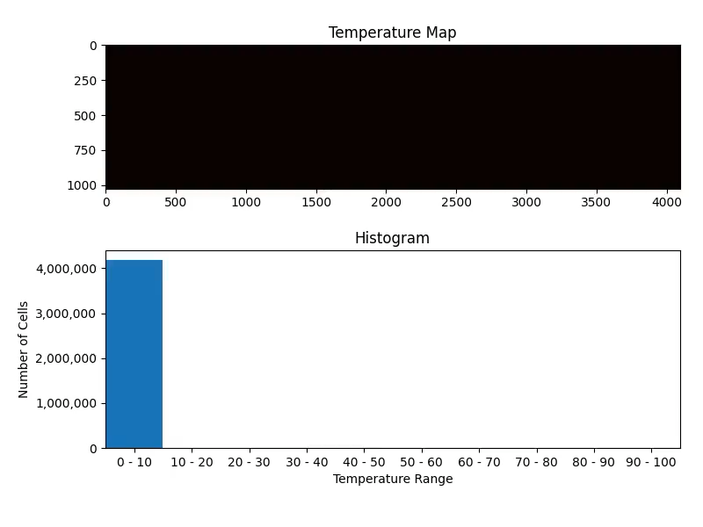
Exercise: Fix Histogram
Solution
We are getting correct results now!
But the performance can’t be worse
Currently getting ~6 GB/s
Notes:
With this fix in place, our results are finally correct.
Notice how the initial temperatures are near zero, so the first bin has the most cells in it.
As heat spreads through the grid, we see more bins start to fill up.
But we have another issue now, the performance can’t be any worse.
We are only getting about 6 GB/s, which is nowhere never GPUs bandwidth.

Slide 65
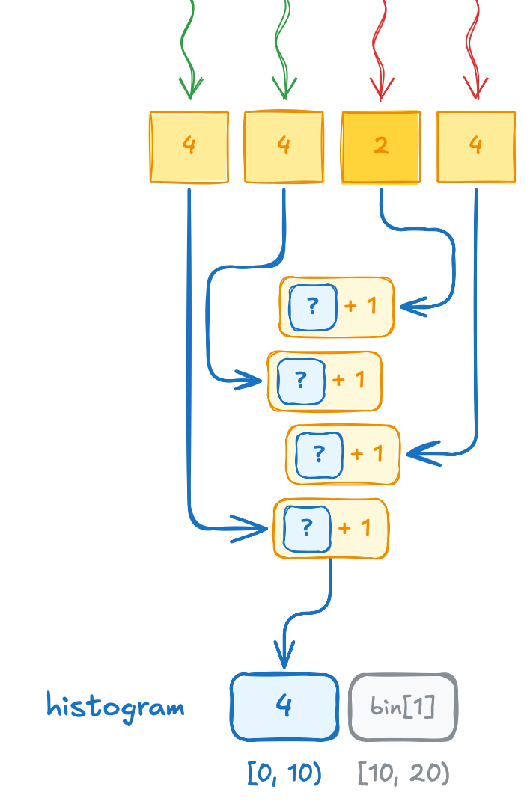
New Source of Serialization
Atomics let us regain functional correctness
But this comes at a cost of serialization of memory accesses
As you know, serialization should be avoided at all costs:
Consider thread block size = 256 and grid size = 16384
If all cells mapping into the same bin,
we’ll get a queue of 4194304 atomics
So, what are our options?
Notes:
Last time we saw such poor performance it was because of serialization.
But this time, we don’t have any loops in our code, so what happened?
This time the serialization is coming from the atomic operations themselves.
While they solve the data-race problem, they can’t run in parallel when all threads target the same memory location.
Instead, each atomic gets queued up, one after another.
We launch about 256 threads, and about 16 thousand blocks.
In total, this gives us a queue of 4 million atomic operations.
Which is obviously too much, but what are our options?

Slide 66
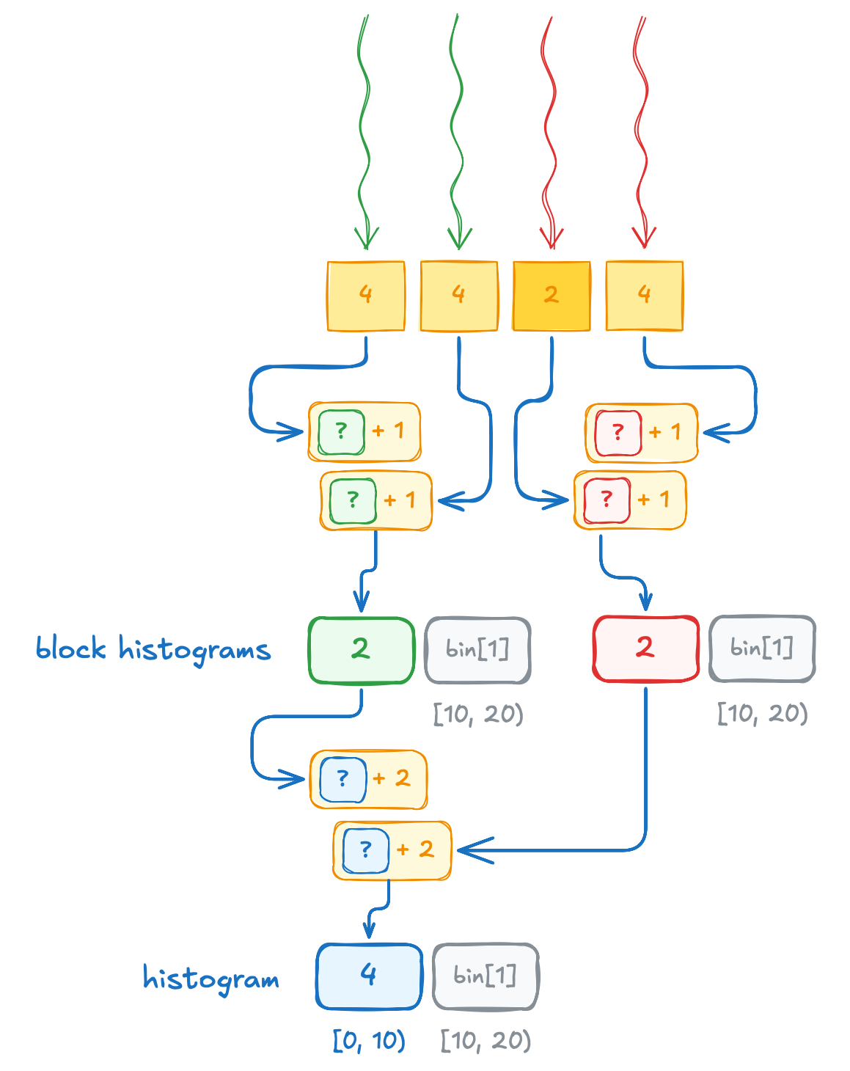
Privatized Histograms
We could add privatized histograms, one per thread block:
Consider thread block size = 256 and grid size = 16384
If all cells mapping into the same bin,
we’ll get a queue of 256 atomics on private histograms followed by 16384 atomics on resulting histogram
In limit, this reduces contention by ~ block size
Notes:
One common solution to this contention is called ‘privatization.’
Instead of having all threads update the same global histogram, we allocate a small ‘private’ histogram for each thread block.
The threads within a block can then safely use atomics on their private histogram.
When they’re done, the block aggregates its counts and updates the main histogram with just one atomic operation.
In our simple two-block example, each block increments its own private histogram to a total of 2 and then adds that 2 into the global histogram once.
Although that might not help much with just two blocks, imagine having 16 thousand of them.
In this scenario, we’d have 16 thousand private histograms updated in parallel, followed by just 16 thousand atomic operations.
This is far fewer than the four million we’d otherwise have if every thread incremented final histogram directly.

Slide 67
Implementing Privatized Histograms
__global__ void histogram_kernel(
cuda::std::span<float> temperatures,
cuda::std::span<int> block_histograms,
cuda::std::span<int> histogram)
{
cuda::std::span<int> block_histogram =
block_histograms.subspan(
blockIdx.x * histogram.size(),
histogram.size());
int cell = blockIdx.x * blockDim.x + threadIdx.x;
int bin = static_cast<int>(temperatures[cell] / bin_width);
cuda::std::atomic_ref<int> block_ref(block_histogram[bin]);
block_ref.fetch_add(1);
if (threadIdx.x < histogram.size())
{
cuda::std::atomic_ref<int> ref(histogram[threadIdx.x]);
ref.fetch_add(block_histogram[threadIdx.x]);
}
}
Histogram kernel now takes another span with per-thread-block histograms
Notes:
To implement this privatization, we add new parameter to our kernel, called block histograms.

Slide 68
Implementing Privatized Histograms
__global__ void histogram_kernel(
cuda::std::span<float> temperatures,
cuda::std::span<int> block_histograms,
cuda::std::span<int> histogram)
{
cuda::std::span<int> block_histogram =
block_histograms.subspan(
blockIdx.x * histogram.size(),
histogram.size());
int cell = blockIdx.x * blockDim.x + threadIdx.x;
int bin = static_cast<int>(temperatures[cell] / bin_width);
cuda::std::atomic_ref<int> block_ref(block_histogram[bin]);
block_ref.fetch_add(1);
if (threadIdx.x < histogram.size())
{
cuda::std::atomic_ref<int> ref(histogram[threadIdx.x]);
ref.fetch_add(block_histogram[threadIdx.x]);
}
}
obtain a view over thread-block private histogram
subspan offset to private histogram is block index multiplied by histogram size
Notes:
Next, we create a subspan for the current thread block’s portion of the privatized histogram.
The subspan function takes an offset and a size.
We calculate the offset by multiplying block index by the histogram size.
So, the first block has an offset of 0, the second block has an offset of 10, and so on.
This ensures each block writes to its own slice of memory.

Slide 69
Implementing Privatized Histograms
__global__ void histogram_kernel(
cuda::std::span<float> temperatures,
cuda::std::span<int> block_histograms,
cuda::std::span<int> histogram)
{
cuda::std::span<int> block_histogram =
block_histograms.subspan(
blockIdx.x * histogram.size(),
histogram.size());
int cell = blockIdx.x * blockDim.x + threadIdx.x;
int bin = static_cast<int>(temperatures[cell] / bin_width);
cuda::std::atomic_ref<int> block_ref(block_histogram[bin]);
block_ref.fetch_add(1);
if (threadIdx.x < histogram.size())
{
cuda::std::atomic_ref<int> ref(histogram[threadIdx.x]);
ref.fetch_add(block_histogram[threadIdx.x]);
}
}
Atomically increment thread-block histograms
Notes:
Then, just as before, each thread computes the bin index.
However, we now increment the privatized block histogram instead of the global one.

Slide 70
Implementing Privatized Histograms
__global__ void histogram_kernel(
cuda::std::span<float> temperatures,
cuda::std::span<int> block_histograms,
cuda::std::span<int> histogram)
{
cuda::std::span<int> block_histogram =
block_histograms.subspan(
blockIdx.x * histogram.size(),
histogram.size());
int cell = blockIdx.x * blockDim.x + threadIdx.x;
int bin = static_cast<int>(temperatures[cell] / bin_width);
cuda::std::atomic_ref<int> block_ref(block_histogram[bin]);
block_ref.fetch_add(1);
if (threadIdx.x < histogram.size())
{
cuda::std::atomic_ref<int> ref(histogram[threadIdx.x]);
ref.fetch_add(block_histogram[threadIdx.x]);
}
}
Contribute private histograms to resulting one
Notes:
After that, each block adds its partial counts back into the global histogram in parallel.
In the code snippet, the first 10 threads in the block each handle one bin from the block’s private histogram.
They use an atomic reference to safely add their local counts to the final histogram

Slide 71
Implementing Privatized Histograms
__global__ void histogram_kernel(
cuda::std::span<float> temperatures,
cuda::std::span<int> block_histograms,
cuda::std::span<int> histogram)
{
cuda::std::span<int> block_histogram =
block_histograms.subspan(
blockIdx.x * histogram.size(),
histogram.size());
int cell = blockIdx.x * blockDim.x + threadIdx.x;
int bin = static_cast<int>(temperatures[cell] / bin_width);
cuda::std::atomic_ref<int> block_ref(block_histogram[bin]);
block_ref.fetch_add(1);
if (threadIdx.x < histogram.size())
{
cuda::std::atomic_ref<int> ref(histogram[threadIdx.x]);
ref.fetch_add(block_histogram[threadIdx.x]);
}
}
⚠
Unfortunately, highlighted code has a bug in it
We mix non-atomic read with atomic increment, which is an undefined behavior
Notes:
Unfortunately, highlighted code has a bug in it.
Let’s take a closer look.

Slide 72
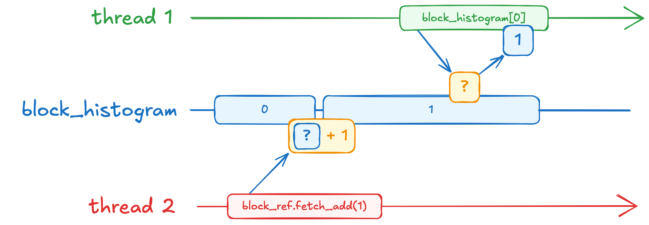
What We Expected
cuda::std::atomic_ref<int> block_ref(block_histogram[bin]);
block_ref.fetch_add(1);
if (threadIdx.x < histogram.size())
{
cuda::std::atomic_ref<int> ref(histogram[threadIdx.x]);
ref.fetch_add(block_histogram[threadIdx.x]);
}
}
We expected all block histogram increments to happen first
And all block histogram reads to happen next
Notes:
In this code, we’ve assumed that all threads finish updating the block histogram before the next section of code begins.
However, CUDA threads in a block run concurrently, without guaranteed ordering.
This means that some threads might’ve not even started running yet while others already exited the kernel!

Slide 73
What Can Happen
cuda::std::atomic_ref<int> block_ref(block_histogram[bin]);
block_ref.fetch_add(1);
if (threadIdx.x < histogram.size())
{
cuda::std::atomic_ref<int> ref(histogram[threadIdx.x]);
ref.fetch_add(block_histogram[threadIdx.x]);
}
}
In practice, we can’t assume any order of operations performed by concurrent threads
We need a mechanism to make sure all threads finished updating block histogram before reading it
Notes:
One of the possible scenarios is that some thread might’ve read the block histogram before it was updated.
To fix this issue, we have to somehow make sure that all threads finished updating the block histogram, before we read it.

Slide 74
Synchronizing in a Thread Block
__syncthreads()
invoked cooperatively by all threads in a thread block
causes threads to wait until all other threads in the thread block arrive
similar to std::barrier, but not allowed inside conditionals
Notes:
CUDA provides a special function called __syncthreads().
It acts as a barrier for all threads in a block.
When a thread reaches this barrier, it waits until every other thread in the same block has arrived.
In that sense, it’s similar to std::barrier, but there’s one important difference.
Every thread in the block must call __syncthreads() from the same logical path.

Slide 75
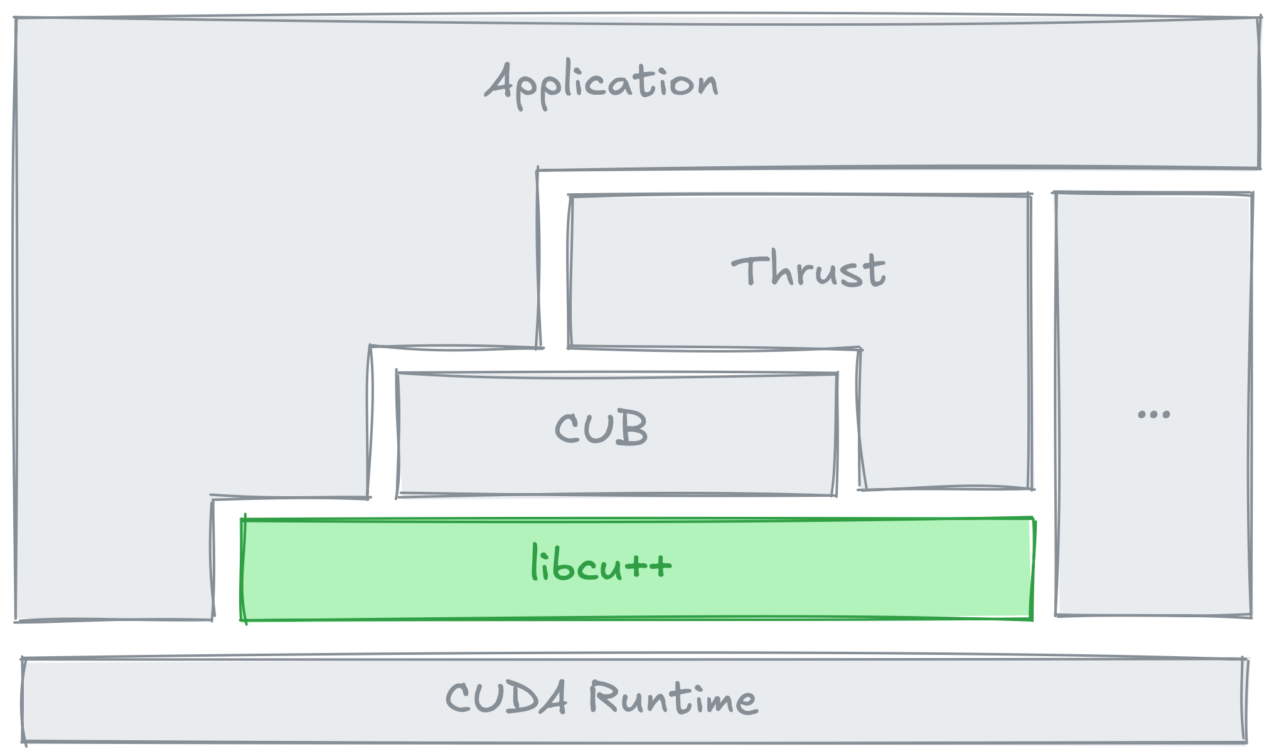
Vocabulary Types in libcu++
Compound Types
cuda::std::pair
cuda::std::tuple
...
Optional and Alternatives
cuda::std::optional
cuda::std::variant
...
Math
cuda::std::complex
...
Synchronization
cuda::std::atomic
cuda::std::atomic_ref
cuda::std::atomic_flag
...
CUDA Extensions
cuda::atomic
cuda::atomic_ref
cuda::atomic_flag
...
https://nvidia.github.io/cccl/libcudacxx
Notes:
[optional – if time permits]
Anyway, __syncthreads() will solve our functional problem, but there’s still a performance concern.
Looking back at the libcu++ overview, you’ll notice two different sets of atomic references - one in the cuda::std namespace and another in the cuda namespace.
Which naturally raises the question: what’s the difference between the two?

Slide 76
Thread Scopes
cuda::std::atomic_ref<int> ref(...);
Both cuda::std::atomic_ref and cuda::atomic_ref have equivalent interface
The only difference is that cuda::atomic_ref extends cuda::std::atomic_ref with additional cuda::thread_scope parameter
Using appropriate thread scope can significantly affect performance
cuda::atomic_ref<int, thread_scope> ref(...);
cuda::thread_scope_system
cuda::thread_scope_device
cuda::thread_scope_block
Notes:
[optional – if time permits]
cuda::std::atomic_ref and cuda::atomic_ref provide essentially the same interface.
However, cuda::atomic_ref extends cuda::std::atomic_ref by adding a thread_scope template parameter.
Choosing the right thread scope can significantly impact performance.
So, let’s take a closer look at what this thread scope is.

Slide 77
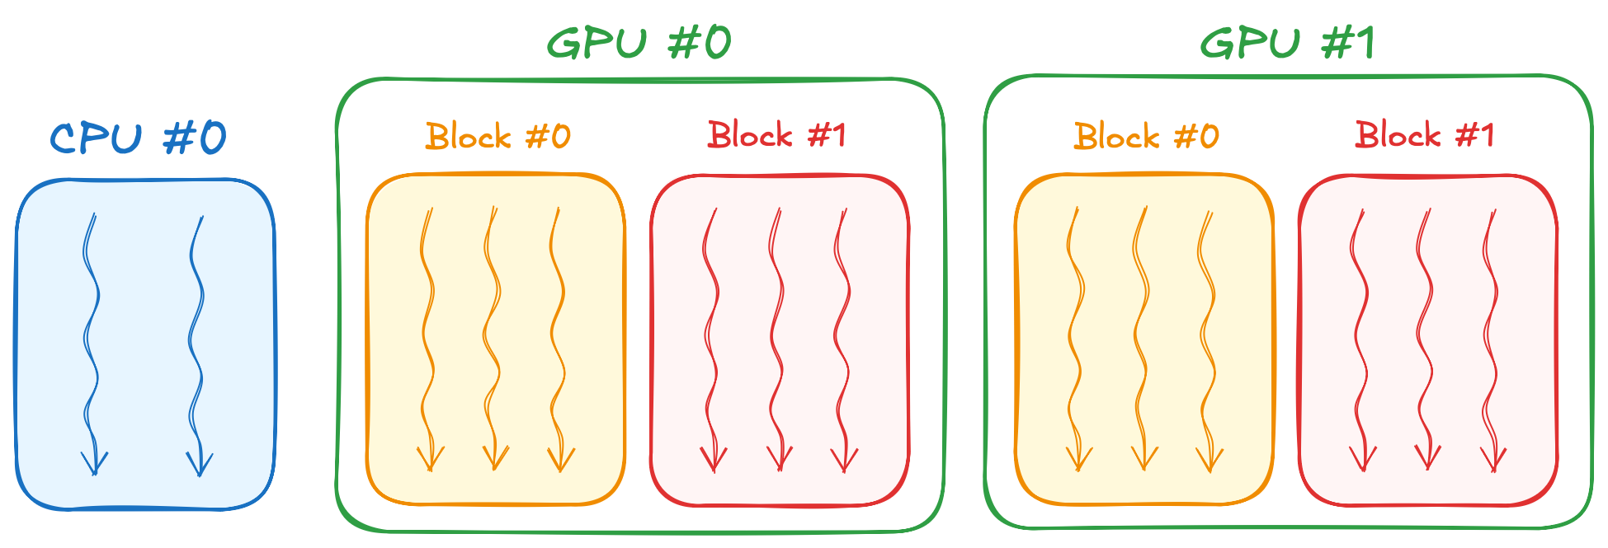
Thread Scope System
cuda::atomic_ref<int, thread_scope> ref(...);
cuda::thread_scope_system
Equivalent to cuda::std::atomic_ref
Each threads of a given system is related to each other thread by system thread scope
cuda::thread_scope_device
cuda::thread_scope_block
Notes:
[optional – if time permits]
Thread scope represents the set of threads that can synchronize using a given atomic.
The scope can be system, device, or block.
For instance, all threads are related to each other by `cuda::thread_scope_system`.
This means that a thread from any GPU (say, in a multi-GPU system) can synchronize with any other GPU thread, or even a CPU thread.
The `cuda::std::atomic_ref` is actually the same thing as cuda::atomic_ref with system scope.

Slide 78
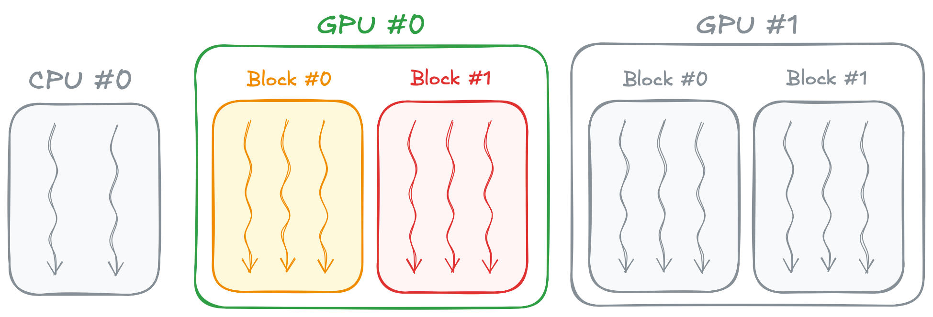
Thread Scope Device
cuda::atomic_ref<int, thread_scope> ref(...);
cuda::thread_scope_system
Each GPU thread is related to each other GPU thread on the same GPU by device thread scope
cuda::thread_scope_device
cuda::thread_scope_block
Notes:
[optional – if time permits]
The next is device scope that relates any thread of a given GPU.
With this scope, multiple GPUs cannot issue atomics into the same memory location.
But since our kernel is running on a single-GPU, device scope is more then enough.

Slide 79
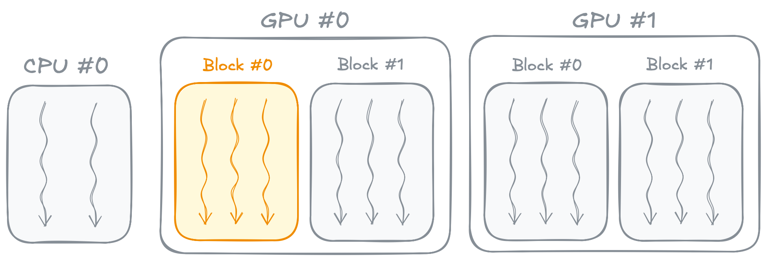
Thread Scope Block
cuda::atomic_ref<int, thread_scope> ref(...);
cuda::thread_scope_system
Each GPU thread is related to each other GPU thread in the same thread block by the block thread scope
cuda::thread_scope_device
cuda::thread_scope_block
Notes:
[optional – if time permits]
And finally, there’s cuda::thread_scope_block, which restricts atomic operations to threads within a single block.
In our kernel, this scope is perfect when updating a block’s private histogram, because only threads within that block need to perform atomics on the same memory location.”

Slide 80
Exercise: Fix Histogram
8 minutes
Use __syncthreads() to make sure all threads updated block histogram before reading it
Reduce thread scope of atomic operations for better performance (optional)
int cell = blockIdx.x * blockDim.x + threadIdx.x;
int bin = static_cast<int>(temperatures[cell] / bin_width);
cuda::std::atomic_ref<int> block_ref(block_histogram[bin]);
block_ref.fetch_add(1);
if (threadIdx.x < histogram.size())
{
cuda::std::atomic_ref<int> ref(histogram[threadIdx.x]);
ref.fetch_add(block_histogram[threadIdx.x]);
}
03.04-Synchronization/03.04.02-Exercise-Fix-Histogram.ipynb
Notes:
Which brings us to the next exercise.
This time, you’ll have to use thread block synchronization to make sure all threads updated block histogram before reading it.
[optional – if time permits] besides that, you’ll have to reduce thread scope of atomic operations to improve performance.
For this, you’ll have 8 minutes starting now.

Slide 81
Exercise: Fix Histogram
Solution
int cell = blockIdx.x * blockDim.x + threadIdx.x;
int bin = static_cast<int>(temperatures[cell] / bin_width);
cuda::atomic_ref<int, cuda::thread_scope_block> block_ref(block_histogram[bin]);
block_ref.fetch_add(1);
__syncthreads();
if (threadIdx.x < histogram.size()) {
cuda::atomic_ref<int, cuda::thread_scope_device> ref(histogram[threadIdx.x]);
ref.fetch_add(block_histogram[threadIdx.x]);
}
This change brings us from 6 GB/s to 100 GB/s
This is much better, but we still have room for improvement
Notes:
Time’s up!
Let’s review the solution.
We started by swapping cuda::std::atomic_ref for cuda::atomic_ref.
Then, we limited the scope of atomic operations on the block histogram to cuda::thread_scope_block and added a thread block synchronization step after those updates.
Finally, we used cuda::thread_scope_device for the global increment, since multiple blocks need to update the same memory location.
This change brought us from 6 GB/s to 100 GB/s, which is an impressive improvement.
That said, we can do even better

Slide 82
Recap
cuda::std::span<int> block_histogram =
block_histograms.subspan(
blockIdx.x * histogram.size(),
histogram.size());
int cell = blockIdx.x * blockDim.x + threadIdx.x;
int bin = static_cast<int>(temperatures[cell] / bin_width);
cuda::atomic_ref<int, cuda::thread_scope_block>
block_ref(block_histogram[bin]);
block_ref.fetch_add(1);
__syncthreads();
if (threadIdx.x < num_bins)
{
cuda::atomic_ref<int, cuda::thread_scope_device>
ref(histogram[threadIdx.x]);
ref.fetch_add(block_histogram[threadIdx.x]);
}
We’ve learned so many things!
Atomic operations
Thread scopes
Sub spans
But what about the initial question?
Why was thread hierarchy needed in the first place?
Notes:
But before optimizing our histogram kernel even further, let’s revisit what we’ve learned so far.
We’ve just covered atomic operations, thread scopes, sub spans, but what about our initial question?
Why was thread hierarchy needed in the first place?

Slide 83
Recap
cuda::std::span<int> block_histogram =
block_histograms.subspan(
blockIdx.x * histogram.size(),
histogram.size());
int cell = blockIdx.x * blockDim.x + threadIdx.x;
int bin = static_cast<int>(temperatures[cell] / bin_width);
cuda::atomic_ref<int, cuda::thread_scope_block>
block_ref(block_histogram[bin]);
block_ref.fetch_add(1);
__syncthreads();
if (threadIdx.x < num_bins)
{
cuda::atomic_ref<int, cuda::thread_scope_device>
ref(histogram[threadIdx.x]);
ref.fetch_add(block_histogram[threadIdx.x]);
}
Let’s reconsider __syncthreads
Synchronization is only available between threads of a given thread block
This makes different groups of threads not equally capable, hence introducing non-uniformity in thread grouping
Are there any other resources that are only accessible within certain groups of threads?
Notes:
Let’s take another look at thread block synchronization, which is only available between threads of a given thread block.
This makes different groups of threads not equally capable, hence introducing non-uniformity in thread grouping and thread hierarchy as a result.
But are there any other resources that are only accessible within certain groups of threads?

Slide 84
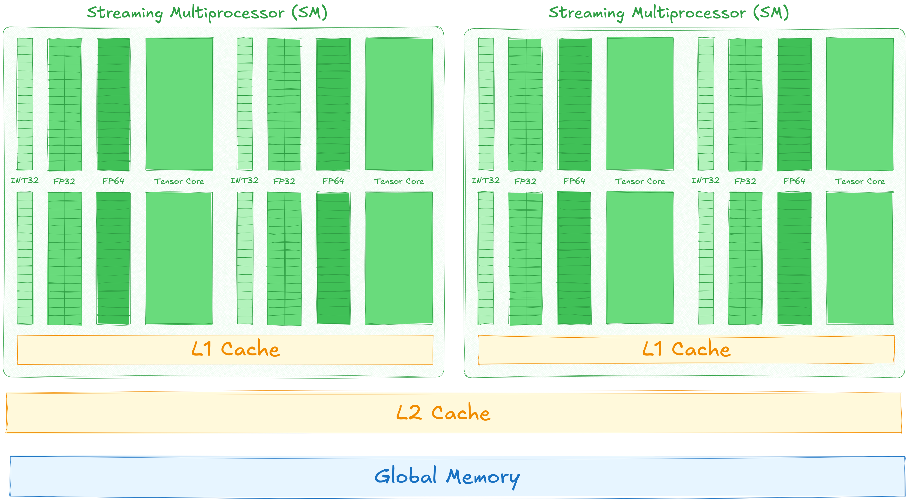
GPUs consist of building blocks called SMs
VRAM is called global memory (not local to any group of threads)
Notes:
To find out, let’s examine the GPU’s architecture.
GPUs are composed of uniform building blocks called Streaming Multiprocessors, or SMs.
A single GPU can contain hundreds them.
Each SM has a lot of cores, but also local L1 cache.
The main GPU memory lives outside these SMs, which is why we call it ‘global’ memory.

Slide 85
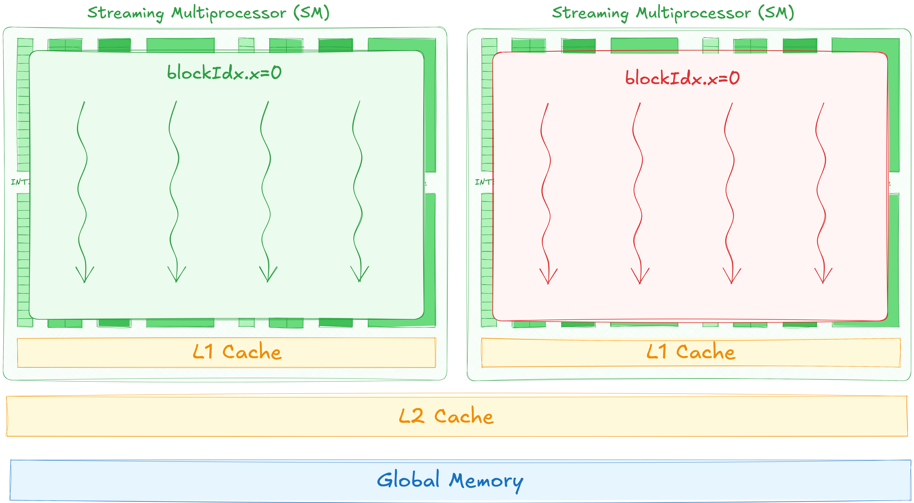
Thread block never spans multiple SMs
Some resources, like __syncthreads and L1 are local to SMs
Notes:
Some features like thread block synchronization are built into the SM hardware.
To use these SM-specific features, thread blocks always run entirely on a single SM.

Slide 86
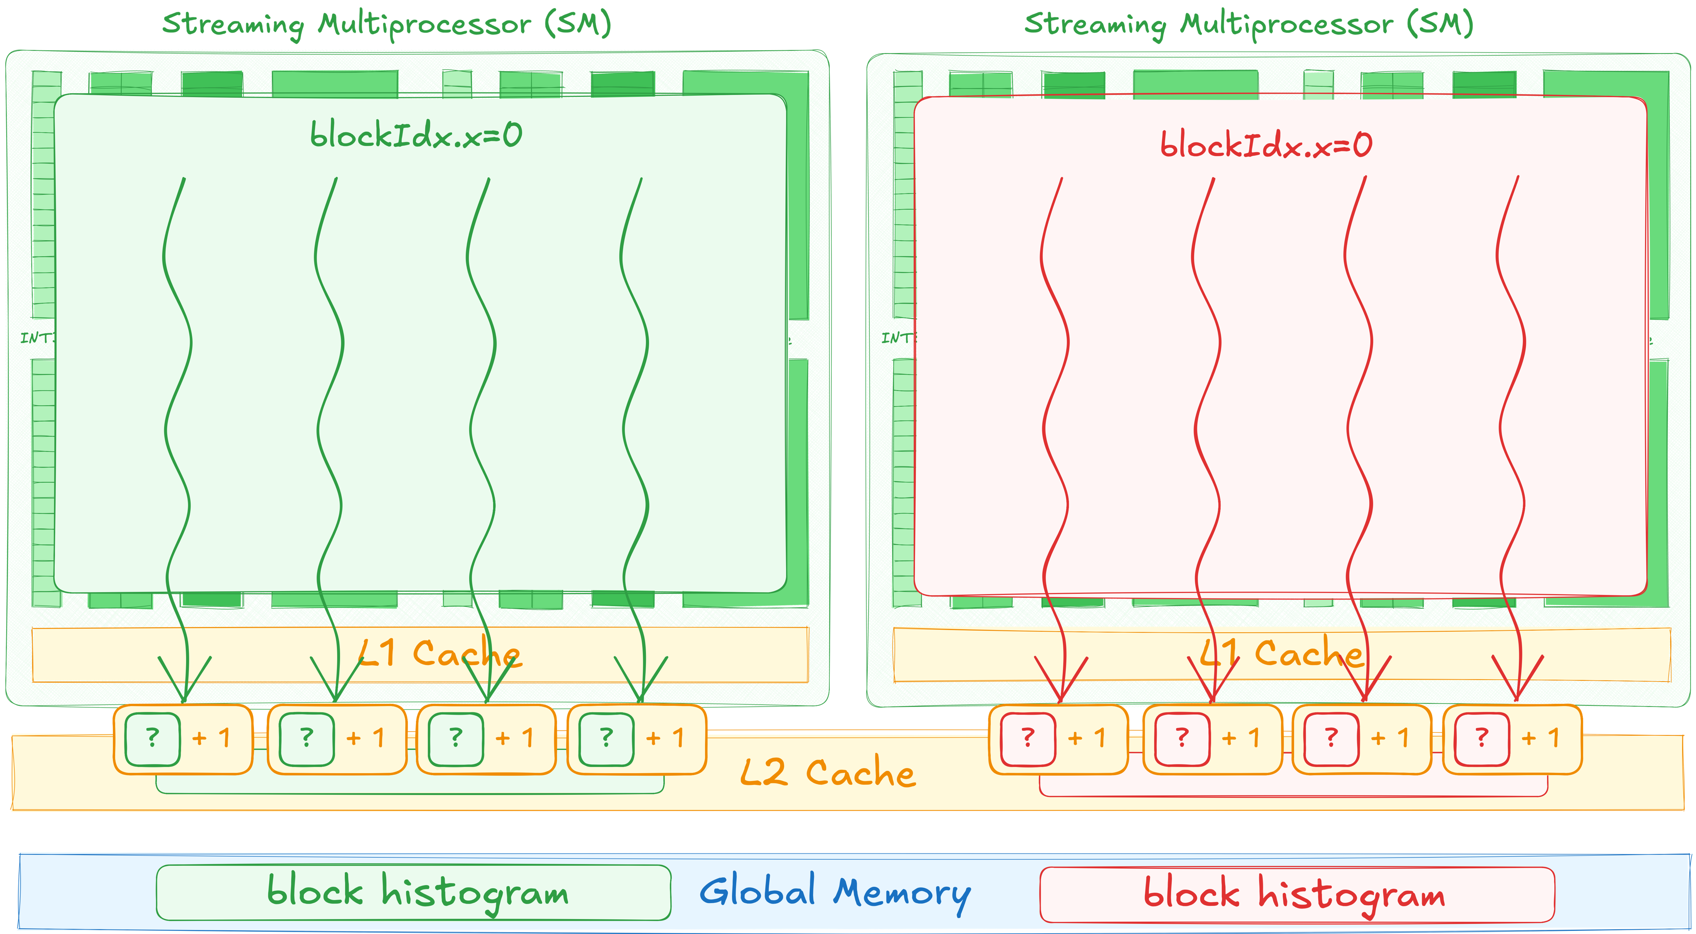
Our kernel repeatedly issues atomic increments, which is likely going into L2
But there’s some inefficiency. We don’t actually need block histograms to be written into global memory. We also waste quite a lot of space (one histogram per thread block)
It’d be nice if we could allocate memory in L1
Notes:
Let’s think about how our histogram kernel maps to this hardware.
Each thread block runs on one SM.
And block histograms are stored in global memory.
Then each thread issues atomics into its block private histogram, which likely go into L2.
That’s not very efficient because we don’t actually need to keep these block histograms around once the kernel finishes.
They’re just temporary storage.
Meanwhile, the L1 cache sits right there on the SM.
If we could allocate the block histogram in L1 directly, we’d avoid wasting space in global memory.
Besides that, L1 cache seems much closer than global memory, so we’d likely improve performance.

Slide 87
We actually can do that!
CUDA provides a software-defined cache that’s called shared memory
Shared memory is only accessible within a given thread block and is collocated with the L1
Notes:
Fortunately, we can do exactly that!
CUDA provides a software defended cache that’s called shared memory.
Shared memory is only accessible within a given thread block and is collocated with L1.

Slide 88
Shared Memory
__global__ void kernel()
{
__shared__ int shared[4];
shared[threadIdx.x] = threadIdx.x;
__syncthreads();
if (threadIdx.x == 0) {
for (int i = 0; i < 4; i++) {
std::printf("shared[%d] = %d\n", i, shared[i]);
}
}
}
To allocate array in shared memory space, use __shared__ specifier
Notes:
To allocate shared memory, we simply add the __shared__ specifier to a variable.
In the example on the slide, I’m declaring an array of four integers as __shared__.

Slide 89
Shared Memory
__global__ void kernel()
{
__shared__ int shared[4];
shared[threadIdx.x] = threadIdx.x;
__syncthreads();
if (threadIdx.x == 0) {
for (int i = 0; i < 4; i++) {
std::printf("shared[%d] = %d\n", i, shared[i]);
}
}
}
You can use it as if it was an ordinary array
Just be mindful of other threads and avoid data races with __syncthreads
Notes:
From within a thread block, you can read and write to this array as you normally would.
In this example, each thread writes its own index into the corresponding element of the array.
Just keep potential data races in mind and use __syncthreads() so that every thread finishes writing before any thread reads the data.

Slide 90
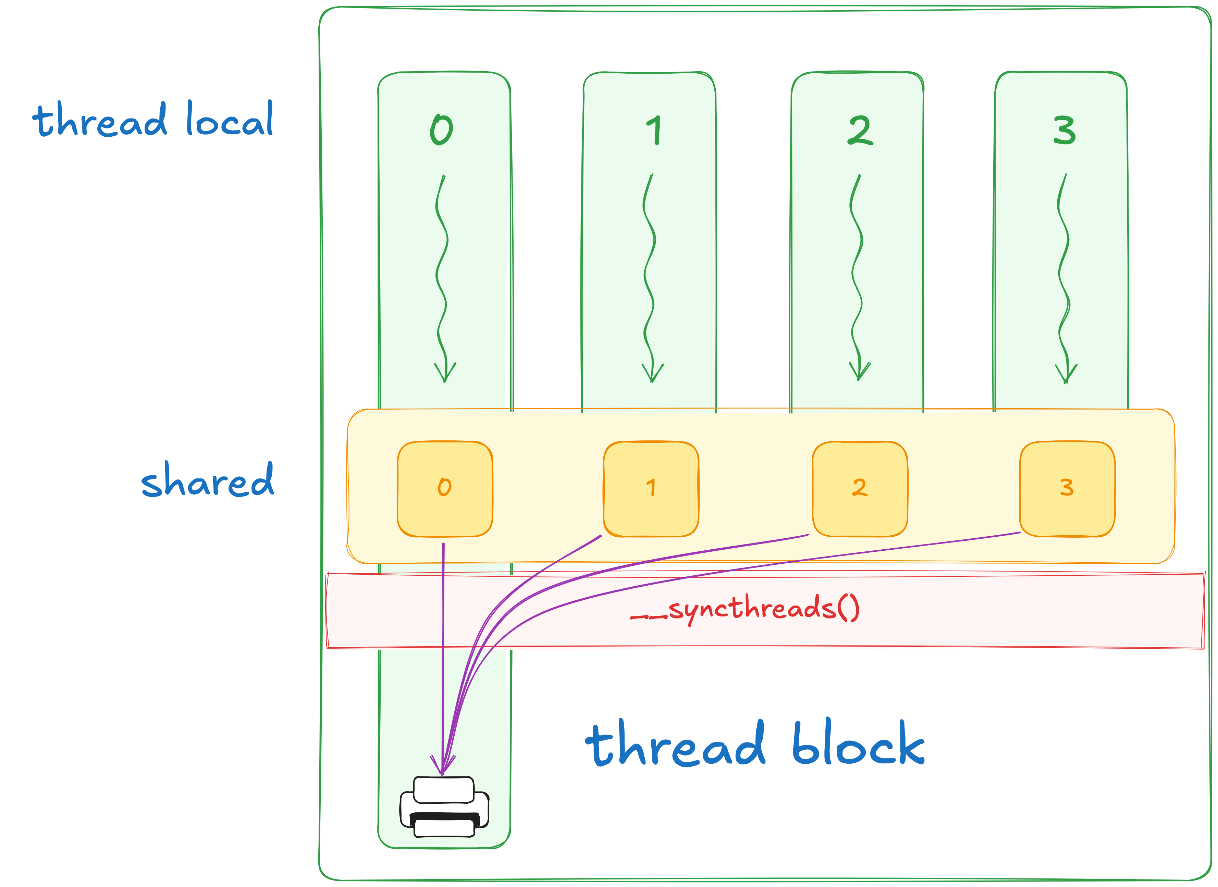
Shared Memory
__global__ void kernel()
{
__shared__ int shared[4];
shared[threadIdx.x] = threadIdx.x;
__syncthreads();
if (threadIdx.x == 0) {
for (int i = 0; i < 4; i++) {
std::printf("shared[%d] = %d\n", i, shared[i]);
}
}
}
Notes:
To emphasize that this shared array is indeed shared across all threads in a block,
I have the first thread print out every value stored in it.
First thread sees the updates from all other threads, and in this case, it prints 0, 1, 2, 3.

Slide 91
Exercise: Optimize Histogram
5 minutes
Use shared instead of global memory to store block histogram
__global__ void histogram_kernel(
cuda::std::span<float> temperatures,
cuda::std::span<int> block_histograms,
cuda::std::span<int> histogram)
{
cuda::std::span<int> block_histogram =
block_histograms.subspan(
blockIdx.x * histogram.size(),
histogram.size());
int cell = blockIdx.x * blockDim.x + threadIdx.x;
int bin = static_cast<int>(temperatures[cell] / bin_width);
cuda::atomic_ref<int, cuda::thread_scope_block>
block_ref(block_histogram[bin]);
block_ref.fetch_add(1);
__syncthreads();
...
03.05-Shared-Memory/03.05.02-Exercise-Optimize-Histogram.ipynb
Notes:
Which brings us the the next exercise.
This time, you’ll have to allocate block histogram in shared memory instead of global one.
For this change, you have 5 minutes starting now.

Slide 92
Exercise: Optimize Histogram
Solution
__global__ void histogram_kernel(
cuda::std::span<float> temperatures,
cuda::std::span<int> histogram)
{
__shared__ int block_histogram[num_bins];
if (threadIdx.x < num_bins) {
block_histogram[threadIdx.x] = 0;
}
__syncthreads();
int cell = blockIdx.x * blockDim.x + threadIdx.x;
int bin = static_cast<int>(temperatures[cell] / bin_width);
cuda::atomic_ref<int, cuda::thread_scope_block>
block_ref(block_histogram[bin]);
block_ref.fetch_add(1);
__syncthreads();
...
Kernel doesn’t need block histograms allocation now
Notes:
Time’s up!
Let’s take a look at the solution.
First, we no longer need block histograms in our kernel signature, so we remove it.

Slide 93
Exercise: Optimize Histogram
Solution
__global__ void histogram_kernel(
cuda::std::span<float> temperatures,
cuda::std::span<int> histogram)
{
__shared__ int block_histogram[num_bins];
if (threadIdx.x < num_bins) {
block_histogram[threadIdx.x] = 0;
}
__syncthreads();
int cell = blockIdx.x * blockDim.x + threadIdx.x;
int bin = static_cast<int>(temperatures[cell] / bin_width);
cuda::atomic_ref<int, cuda::thread_scope_block>
block_ref(block_histogram[bin]);
block_ref.fetch_add(1);
__syncthreads();
...
We start by allocating block histogram in shared memory
Then we initialize block histogram to zero by first threads
And synchronize block to make sure other threads wait for block histogram to be properly initialized
Notes:
Next, we allocate block histogram in shared memory and then initialize it to zero before the first use.
After that, we synchronize thread block, to avoid possible data races.

Slide 94
Exercise: Optimize Histogram
Solution
__global__ void histogram_kernel(
cuda::std::span<float> temperatures,
cuda::std::span<int> histogram)
{
__shared__ int block_histogram[num_bins];
if (threadIdx.x < num_bins) {
block_histogram[threadIdx.x] = 0;
}
__syncthreads();
int cell = blockIdx.x * blockDim.x + threadIdx.x;
int bin = static_cast<int>(temperatures[cell] / bin_width);
cuda::atomic_ref<int, cuda::thread_scope_block>
block_ref(block_histogram[bin]);
block_ref.fetch_add(1);
__syncthreads();
...
We then wrap shared memory reference to an atomic reference as usual
Notes:
And finally, we wrap this shared block histogram in atomic reference, just like before.
The rest of the code remains unchanged.

Slide 95
Exercise: Optimize Histogram
Solution
Overall, this brings us from 100 GB/s to 400 GB/s
Notes:
And this change brings us to 400 GB/s, leading to about 4x speedup.
Finally, our kernel is functional and performant.
But we’ve made a higher-level mistake.
When we first started using GPUs, we relied on accelerated libraries.
But as soon as we started writing our own CUDA kernels, we’ve been implementing everything from scratch.

Slide 96
Cooperative Libraries
CUB
Cooperative general-purpose algorithms inside CUDA kernel
cuBLASDx
Cooperative linear algebra functions inside CUDA kernel
cuFFTDx
Cooperative fast Fourier transform inside CUDA kernel
…
Authoring a CUDA kernel doesn’t mean implementing every algorithm from scratch
CUDA provides variety of cooperative libraries that make your kernels faster and development times shorter
Notes:
Authoring a CUDA kernel doesn’t mean you have to reinvent every algorithm from scratch.
CUDA offers a range of cooperative libraries that speed up your kernels and shorten development time.
For example, CUB provides general-purpose cooperative algorithms for reductions, prefix sums, and sorting.
Meanwhile, cuBLASDx handles cooperative linear algebra functions, and cuFFTDx offers cooperative Fourier Transforms.

Slide 97
Cooperative Libraries
CUB
Cooperative general-purpose algorithms inside CUDA kernel
cuBLASDx
Cooperative linear algebra functions inside CUDA kernel
cuFFTDx
Cooperative fast Fourier transform inside CUDA kernel
…
Authoring a CUDA kernel doesn’t mean implementing every algorithm from scratch
CUDA provides variety of cooperative libraries that make your kernels faster and development times shorter
But what exactly does cooperative mean?
Notes:
But what exactly does ‘cooperative’ mean in this context?

Slide 98
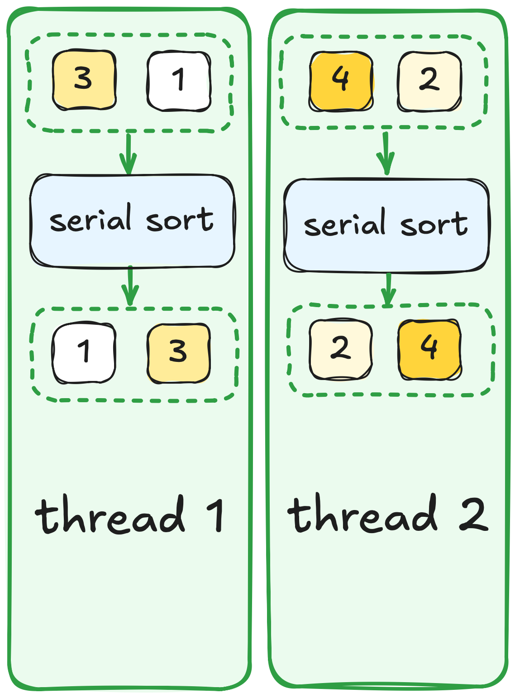
Cooperative Algorithms
Serial
One thread invokes algorithm
One thread executes algorithm
Notes:
To explain what ‘cooperative’ means, let’s review the types of algorithms we’ve encountered so far.
We began with std::sort, which is a serial algorithm.
A serial algorithm is both called and executed by a single thread.
So, if two different threads each call a serial algorithm, the inputs from one thread can not affect the outputs of the other.

Slide 99
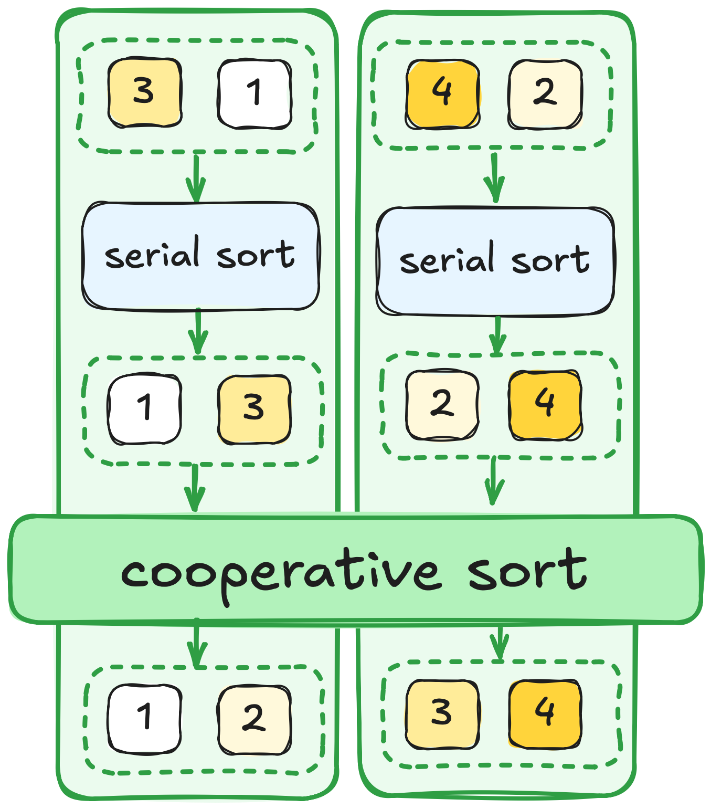
Cooperative Algorithms
Serial
One thread invokes algorithm
One thread executes algorithm
Cooperative
Many threads invoke algorithm
Many threads execute algorithm
Notes:
Cooperative algorithms, on the other hand, are invoked by multiple threads and are executed cooperatively among them.
You can imagine the input to these cooperative algorithms as if one large ‘virtual’ array, that just happened to be split across different threads.
The same goes for the output.
In the example on the slide, a cooperative sort takes elements [1, 3] from the first thread and [2, 4] from the second.
After sorting cooperatively, the first thread’s output becomes [1, 2], even though 2 originally came from the second thread.

Slide 100
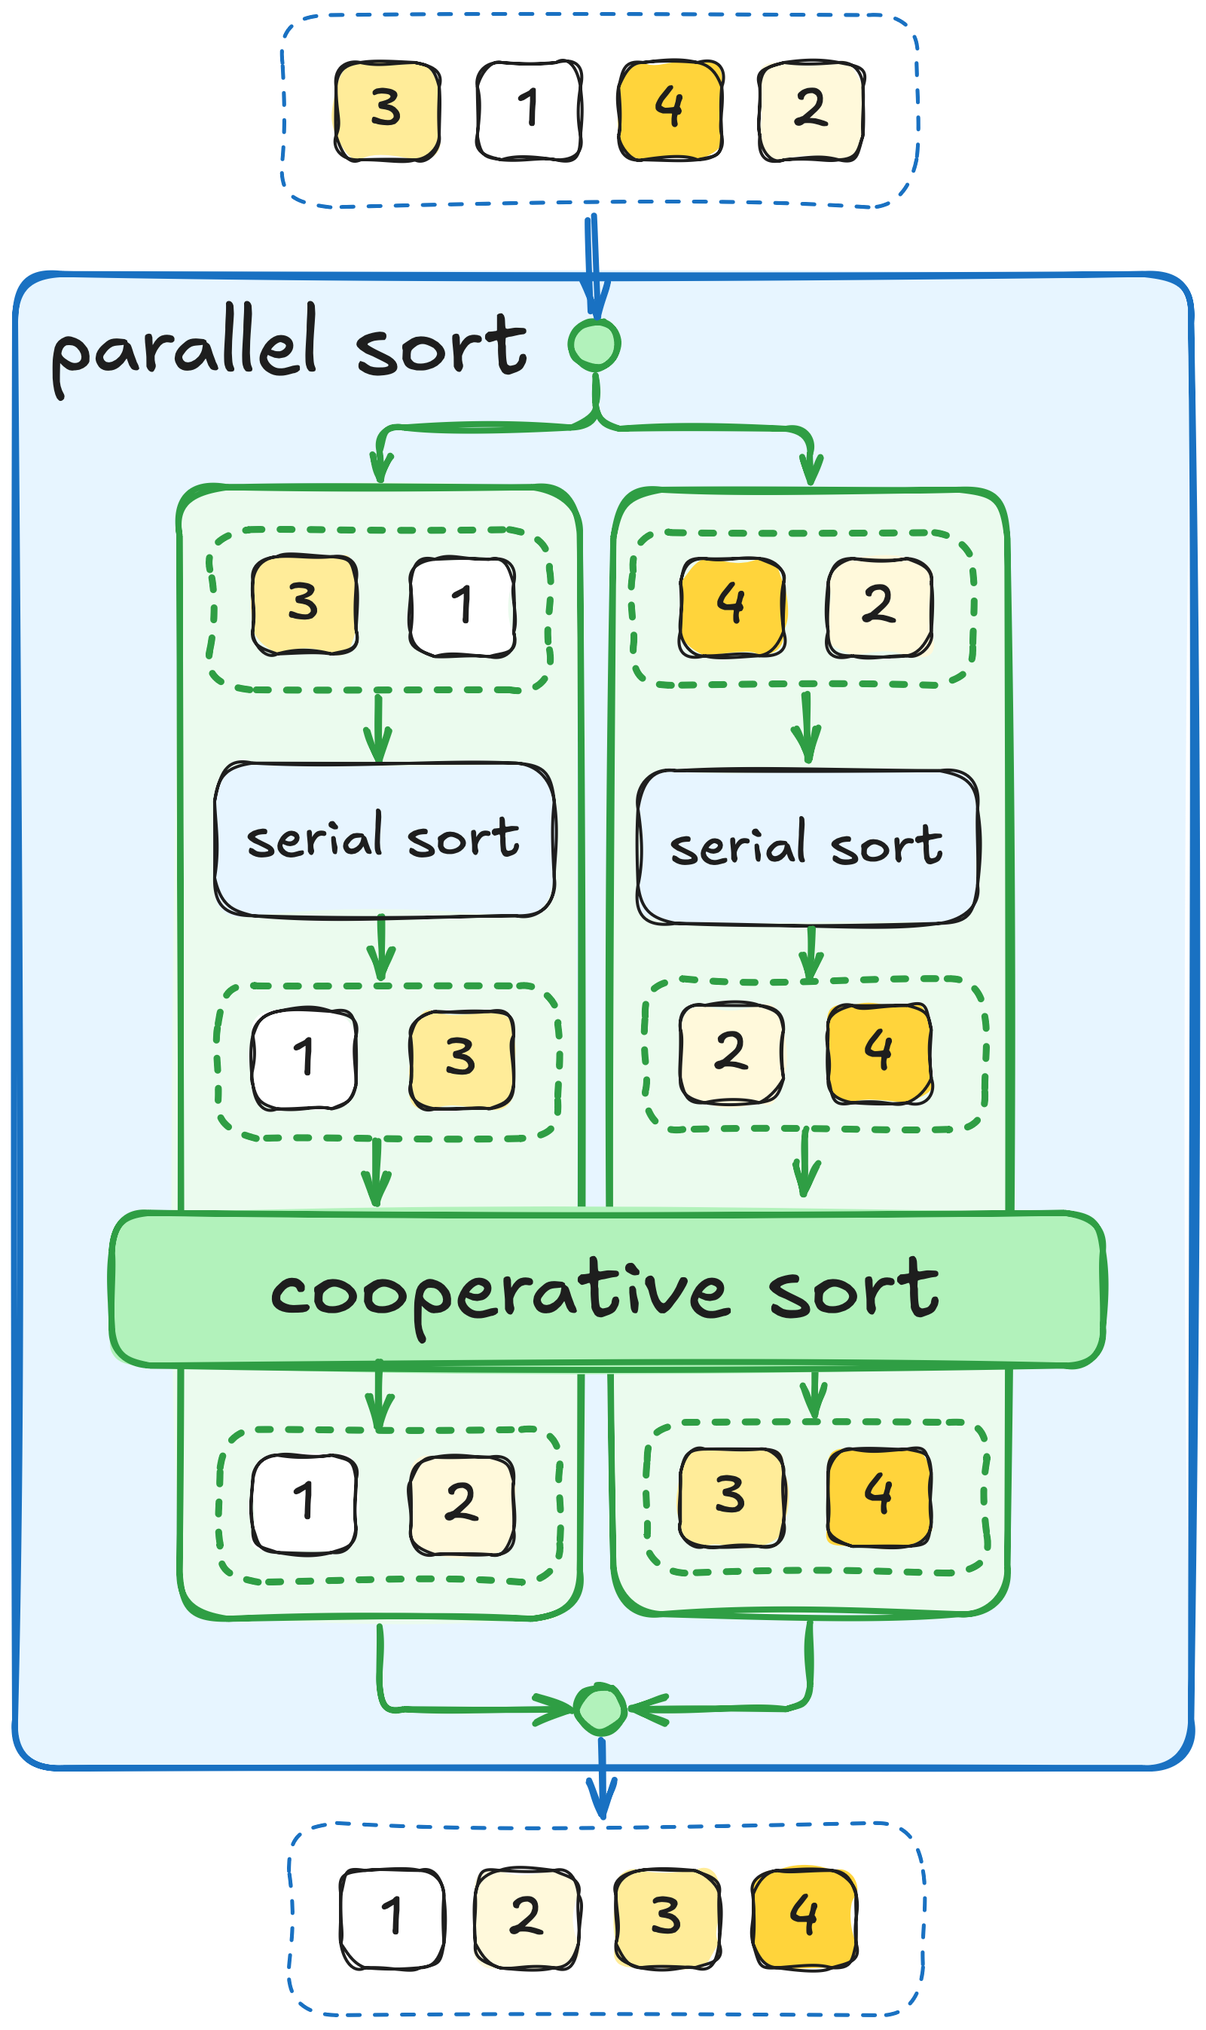
Cooperative Algorithms
Serial
One thread invokes algorithm
One thread executes algorithm
Cooperative
Many threads invoke algorithm
Many threads execute algorithm
Parallel
One thread invokes algorithm
Many threads execute algorithm
Notes:
We’ve also used parallel algorithms, which are called by a single thread but executed by many threads behind the scenes.
From a user’s perspective, these algorithms appear ‘serial,’ since you just call them like any other function.
However, under the hood, they distribute the work among multiple threads to complete the task faster.
Some examples of parallel algorithms we’ve used so far include thrust::transform and cub::DeviceTransform.

Slide 101
Mental Model
Cooperative algorithms frequently need shared memory for inter-thread communication
All threads of a block are expected to participate in block-level cooperative algorithm
Sometimes output is valid only in main thread
Notes:
Now, let’s look more closely at cooperative algorithms.
On the slide you can see how cooperative reduction might work.
Here, all threads provide a single value into cooperative reduction.
First thread contributes 0, second one contributes 1 at so forth.
Inside the cooperative algorithm, these values are written into shared memory.
After thread block synchronization, a smaller set of threads computes partial sums and writes them back.
After one more synchronization, the total sum (6 in our simplified example) is returned to the first thread.
Although this is a very basic model, it illustrates two key points about cooperative algorithms:
1. They rely on shared memory for data exchange between threads
2. They may include synchronization steps.
This means if any thread in the block fails to call the cooperative algorithm, the entire kernel could deadlock.

Slide 102
CUB Interface
template <typename T, int BlockDimX>
struct cub::BlockReduce
{
struct TempStorage { ... };
__device__ BlockReduce(TempStorage& temp_storage) { ... }
__device__ T Sum(T input) { return ...; }
}
Unlike traditional function-oriented interfaces, CUB exposes its cooperative algorithms as templated structs
Template parameters used to specialize algorithms for the problem at hands:
data type (int, float, etc.)
number of threads in the thread block
grain size (number of items per thread)
etc.
Notes:
Let’s see how this intuition applies to real code.
On the screen you can see a cooperative reduction provided by CUB.
Unlike traditional function-oriented interfaces, CUB exposes its cooperative algorithms as templated structures.
Template parameters are used to specialize algorithms for the problem at hands.
Say, we can specify that we want to reduce integers, within a block of 256 threads.

Slide 103
CUB Interface
template <typename T, int BlockDimX>
struct cub::BlockReduce
{
struct TempStorage { ... };
__device__ BlockReduce(TempStorage& temp_storage) { ... }
__device__ T Sum(T input) { return ...; }
}
Nested TempStorage type provides type of temporary storage needed by cooperative algorithm for thread communication
Instance of this type has to be allocated in shared memory
TempStorage allocation must be provided to construct an instance of the algorithm
Notes:
Next, there’s a nested TempStorage type, which specifies the kind of temporary storage the cooperative algorithm needs for its internal communication.
We allocate an instance of this type in shared memory, then pass a reference to that shared-memory instance when we construct the cooperative algorithm.

Slide 104
CUB Interface
template <typename T, int BlockDimX>
struct cub::BlockReduce
{
struct TempStorage { ... };
__device__ BlockReduce(TempStorage& temp_storage) { ... }
__device__ T Sum(T input) { return ...; }
}
Member functions represent different flavors of a given cooperative algorithms
__shared__ cub::BlockReduce<int, 4>::TempStorage storage;
int block_sum = cub::BlockReduce<int, 4>(storage).Sum(threadIdx.x);
Notes:
Finally, member functions provide different flavors of a given cooperative algorithm.

Slide 105
CUB Interface
__shared__ cub::BlockReduce<int, 4>::TempStorage storage;
cub::BlockReduce<int, 4> reducer(storage);
int block_sum = reducer.Sum(threadIdx.x);
Allocate temporary storage in shared memory
Construct an instance of the algorithm
Invoke method of the algorithm instance
Notes:
So, putting it all together, usage of this cooperative algorithm looks as follows.
We instantiate block reduction for reducing integers within a thread block of size 4.
Then allocate nested temp storage type in shared memory,
Construct an instance of this cooperative algorithm structure and finally call a cooperative algorithm.

Slide 106
CUB Block-Level Algorithms
cub::BlockDiscontinuity
cub::BlockExchange
cub::BlockHistogram
cub::BlockLoad
cub::BlockMergeSort
cub::BlockRadixSort
cub::BlockRadixRank
cub::BlockReduce
cub::BlockRunLengthDecode
cub::BlockScan
cub::BlockShuffle
cub::BlockStore
CUB provides many general-purpose algorithms at thread block level
Notes:
CUB provides many general-purpose algorithms at a thread block level

Slide 107
CUB Block-Level Algorithms
cub::BlockDiscontinuity
cub::BlockExchange
cub::BlockHistogram
cub::BlockLoad
cub::BlockMergeSort
cub::BlockRadixSort
cub::BlockRadixRank
cub::BlockReduce
cub::BlockRunLengthDecode
cub::BlockScan
cub::BlockShuffle
cub::BlockStore
CUB provides many general-purpose algorithms at thread block level
Notes:
And one of these cooperative algorithms is actually a block histogram

Slide 108
CUB Block-Level Algorithms
template <
typename T, - type of histogram bins (int)
int BlockDimX, - number of threads in a thread block
int ItemsPerThread, - number of bins in each thread
int Bins, - number of bins in the histogram
cub::BlockHistogramAlgorithm - algorithm for histogram implementation
Algorithm = BLOCK_HISTO_SORT>
class cub::BlockHistogram
{
struct TempStorage
{ ... };
__device__ BlockHistogram(TempStorage& temp_storage)
{ ... }
template <typename CounterT>
__device__ void Histogram(T (&items)[ITEMS_PER_THREAD], - thread bins
CounterT histogram[BINS]) - block histogram (in shared memory)
{ ... }
};
cub::BlockHistogram::Histogram initializes shared histogram and incorporates bin indices provides by each thread
Notes:
Block histogram structure has a few template parameters as well.
First, we have to specify the type of the histogram elements, which is int in our case.
Then, we have to specify the thread block size, like 256.
Then, we also specify how many bins each thread is going to contribute.
And lastly, we have to specify how many bins are there in our histogram.
Then, the block histogram usage is very similar to what we’ve seen before.

Slide 109
Exercise: Use Cooperative Histogram
8 minutes
Use cub::BlockHistogram to compute block histogram
__shared__ int block_histogram[10];
int cell = blockIdx.x * blockDim.x + threadIdx.x;
int bins[1] = {static_cast<int>(temperatures[cell] / 10)};
if (threadIdx.x < 10)
{
block_histogram[threadIdx.x] = 0;
}
__syncthreads();
cuda::atomic_ref<int, cuda::thread_scope_block>
block_ref(block_histogram[bin]);
block_ref.fetch_add(1);
__syncthreads();
...
03.06-Cooperative-Algorithms/03.06.02-Exercise-Cooperative-Histogram.ipynb
Notes:
Which brings us to the final exercise in this section.
This time, you’ll have to use cub::BlockHistogram in our histogram kernel instead of implementing it from scratch.
For this, you’ll have 8 minutes starting now.

Slide 110
Exercise: Use Cooperative Histogram
Solution
__shared__ int block_histogram[10];
int cell = blockIdx.x * blockDim.x + threadIdx.x;
int bins[1] = {static_cast<int>(temperatures[cell] / 10)}; using histogram_t = cub::BlockHistogram<int, block_size, 1, 10>;
__shared__ typename histogram_t::TempStorage temp_storage;
histogram_t(temp_storage).Histogram(bins, block_histogram);
__syncthreads();
...

Slide 111
Takeaways
Write custom CUDA kernels only when:
Your use case is not covered by existing accelerated libraries
10 compute steps take:
cub: 0.000043
1 thread: 4.15
2 threads: 2.6
256 threads: 0.037
5’120’000 threads: 0.0003

Slide 112
Takeaways
Write custom CUDA kernels only when:
Your use case is not covered by existing accelerated libraries
Use __syncthreads:
To avoid data races within a thread block

Slide 113
Takeaways
Write custom CUDA kernels only when:
Your use case is not covered by existing accelerated libraries
Use __syncthreads:
To avoid data races within a thread block
Use __shared__:
When you need a temporary storage inside a thread block
When you need to exchange data between threads of a thread block
When your data is not efficiently cached by L1

Slide 114
Takeaways
Write custom CUDA kernels only when:
Your use case is not covered by existing accelerated libraries
Use __syncthreads:
To avoid data races within a thread block
Use __shared__:
When you need a temporary storage inside a thread block
When you need to exchange data between threads of a thread block
When your data is not efficiently cached by L1
Use device-side libraries:
CUB for block, and warp-scope cooperative general-purpose algorithms
libcudacxx for vocabulary types
cuBLASDx for linear algebra
cuFFTDx for FFT
etc.

Slide 115
Takeaways
Write custom CUDA kernels only when:
Your use case is not covered by existing accelerated libraries
Use __syncthreads:
To avoid data races within a thread block
Use __shared__:
When you need a temporary storage inside a thread block
When you need to exchange data between threads of a thread block
When your data is not efficiently cached by L1
Use device-side libraries:
CUB for block, and warp-scope cooperative general-purpose algorithms
libcudacxx for vocabulary types
cuBLASDx for linear algebra
cuFFTDx for FFT
etc.
Use developer tools:
compute-sanitizer for CUDA kernels correctness checking
cuda-gdb for CUDA kernels debugging
Use NVIDIA Nsight Systems to identify bottlenecks in your application
NVIDIA Nsight Compute for in-depth kernel profiling

Slide 116
Final Assessment

Slide 117
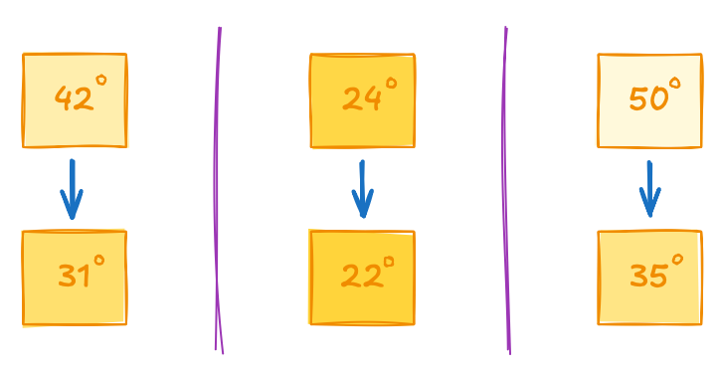
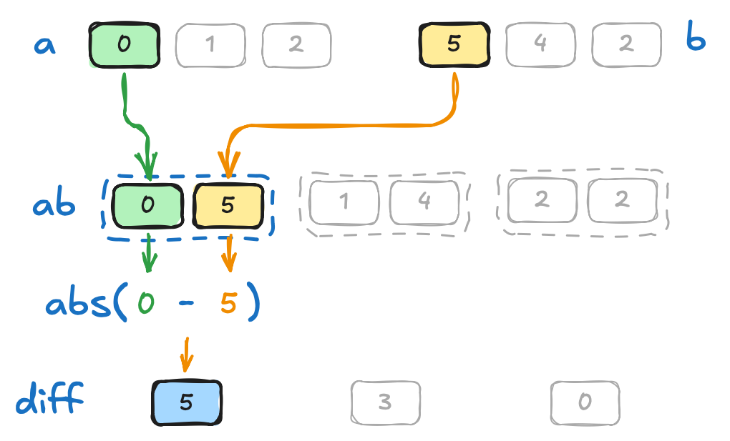
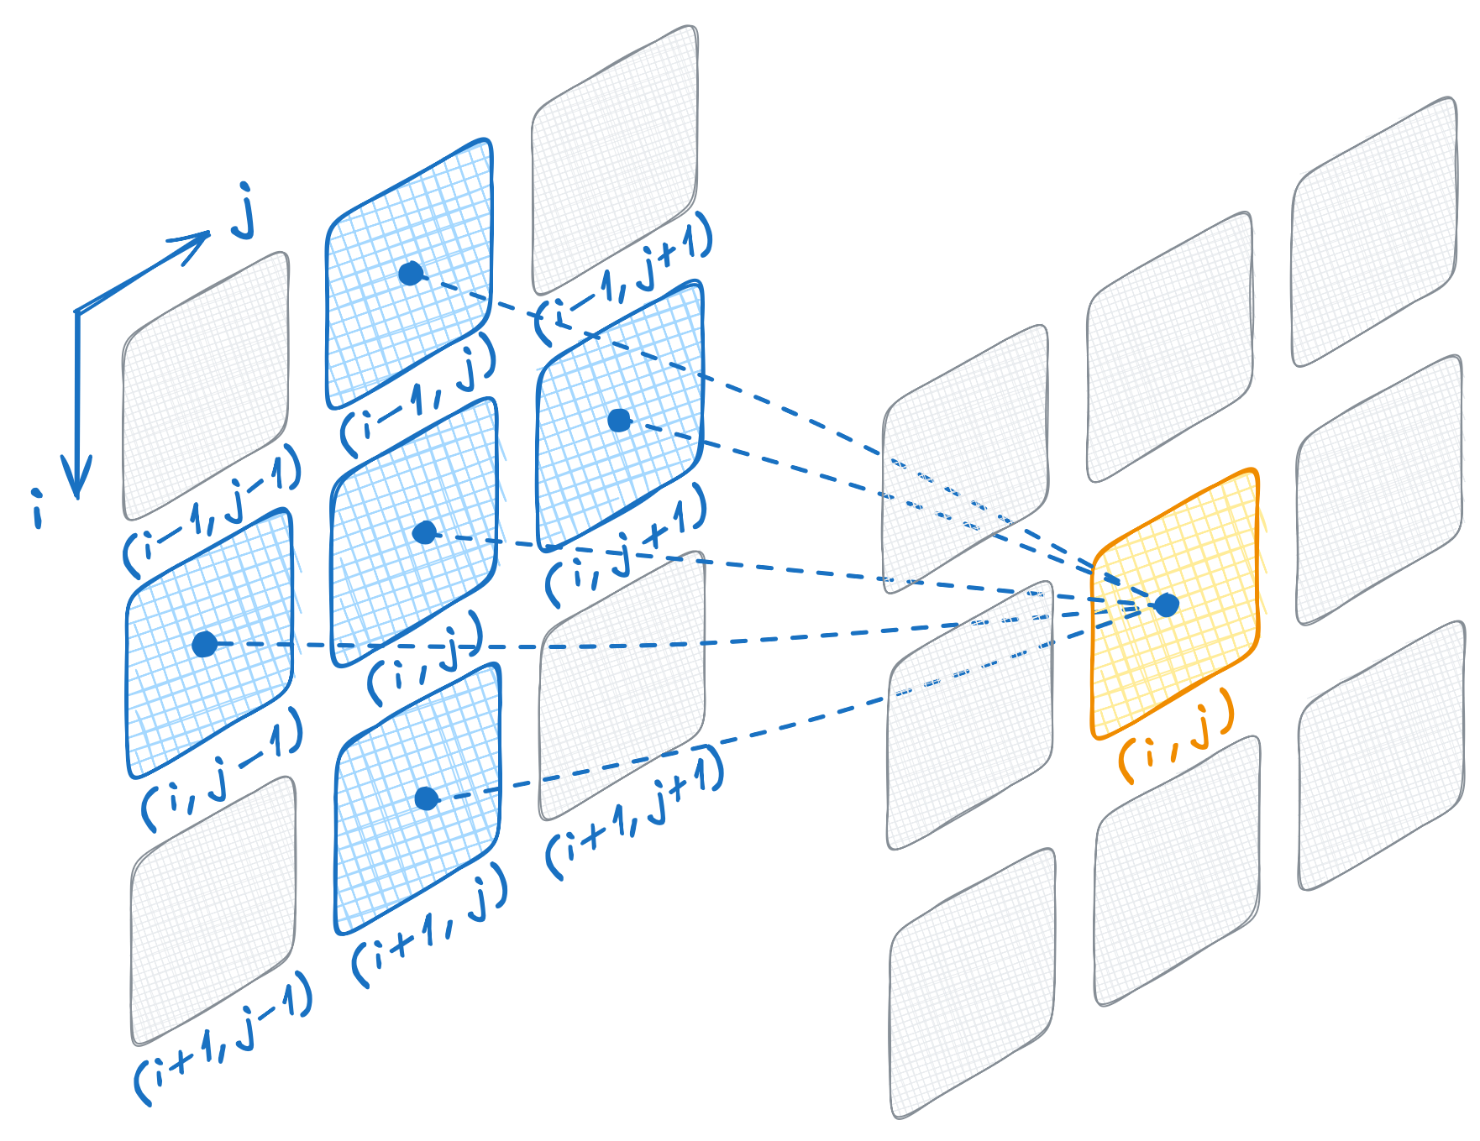
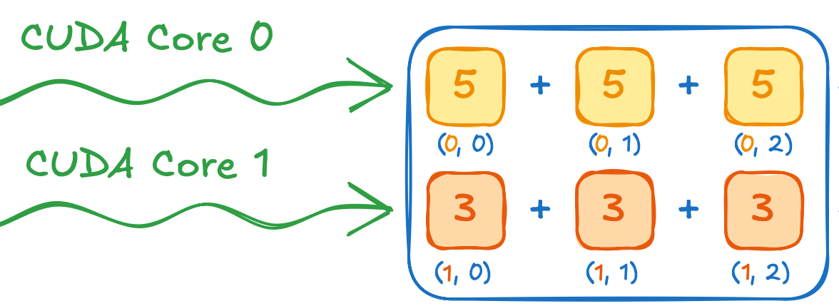
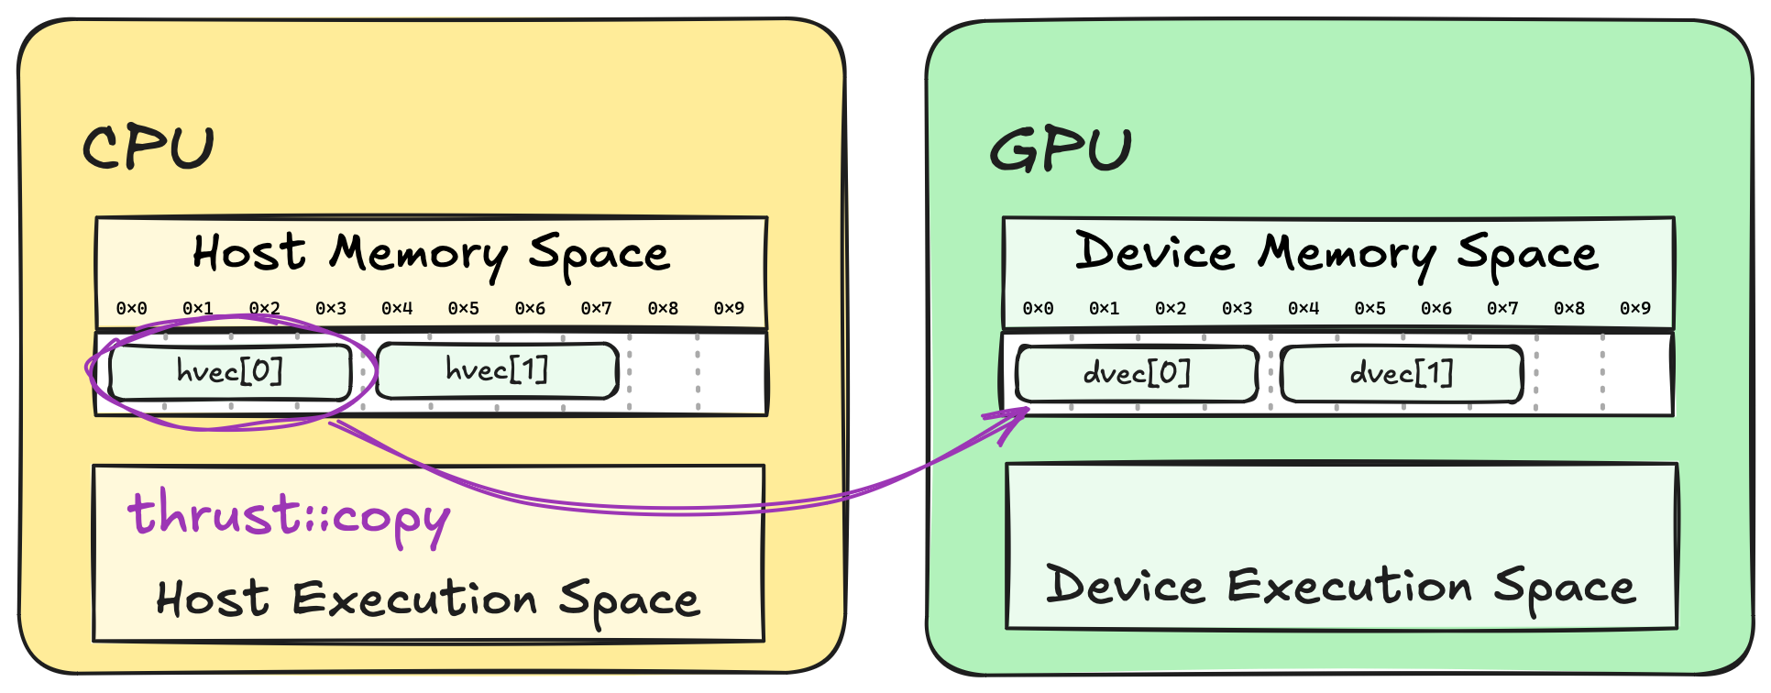
Final Review
Learn 1.2 Execution Spaces as we accelerate naïve cooling simulator and achieve16x speedup
Learn 1.3 Extending Algorithms with fancy iterators to achieve 2x speedup
Learn 1.4 Vocabulary Types as we transition from naive cooling to stencil-based simulation
Learn concept of 1.5 Parallelism as we accelerate one of the algorithms by 300x
Learn concept of 1.6 Memory Spaces as we accelerate one of the algorithms by 100x

Slide 118
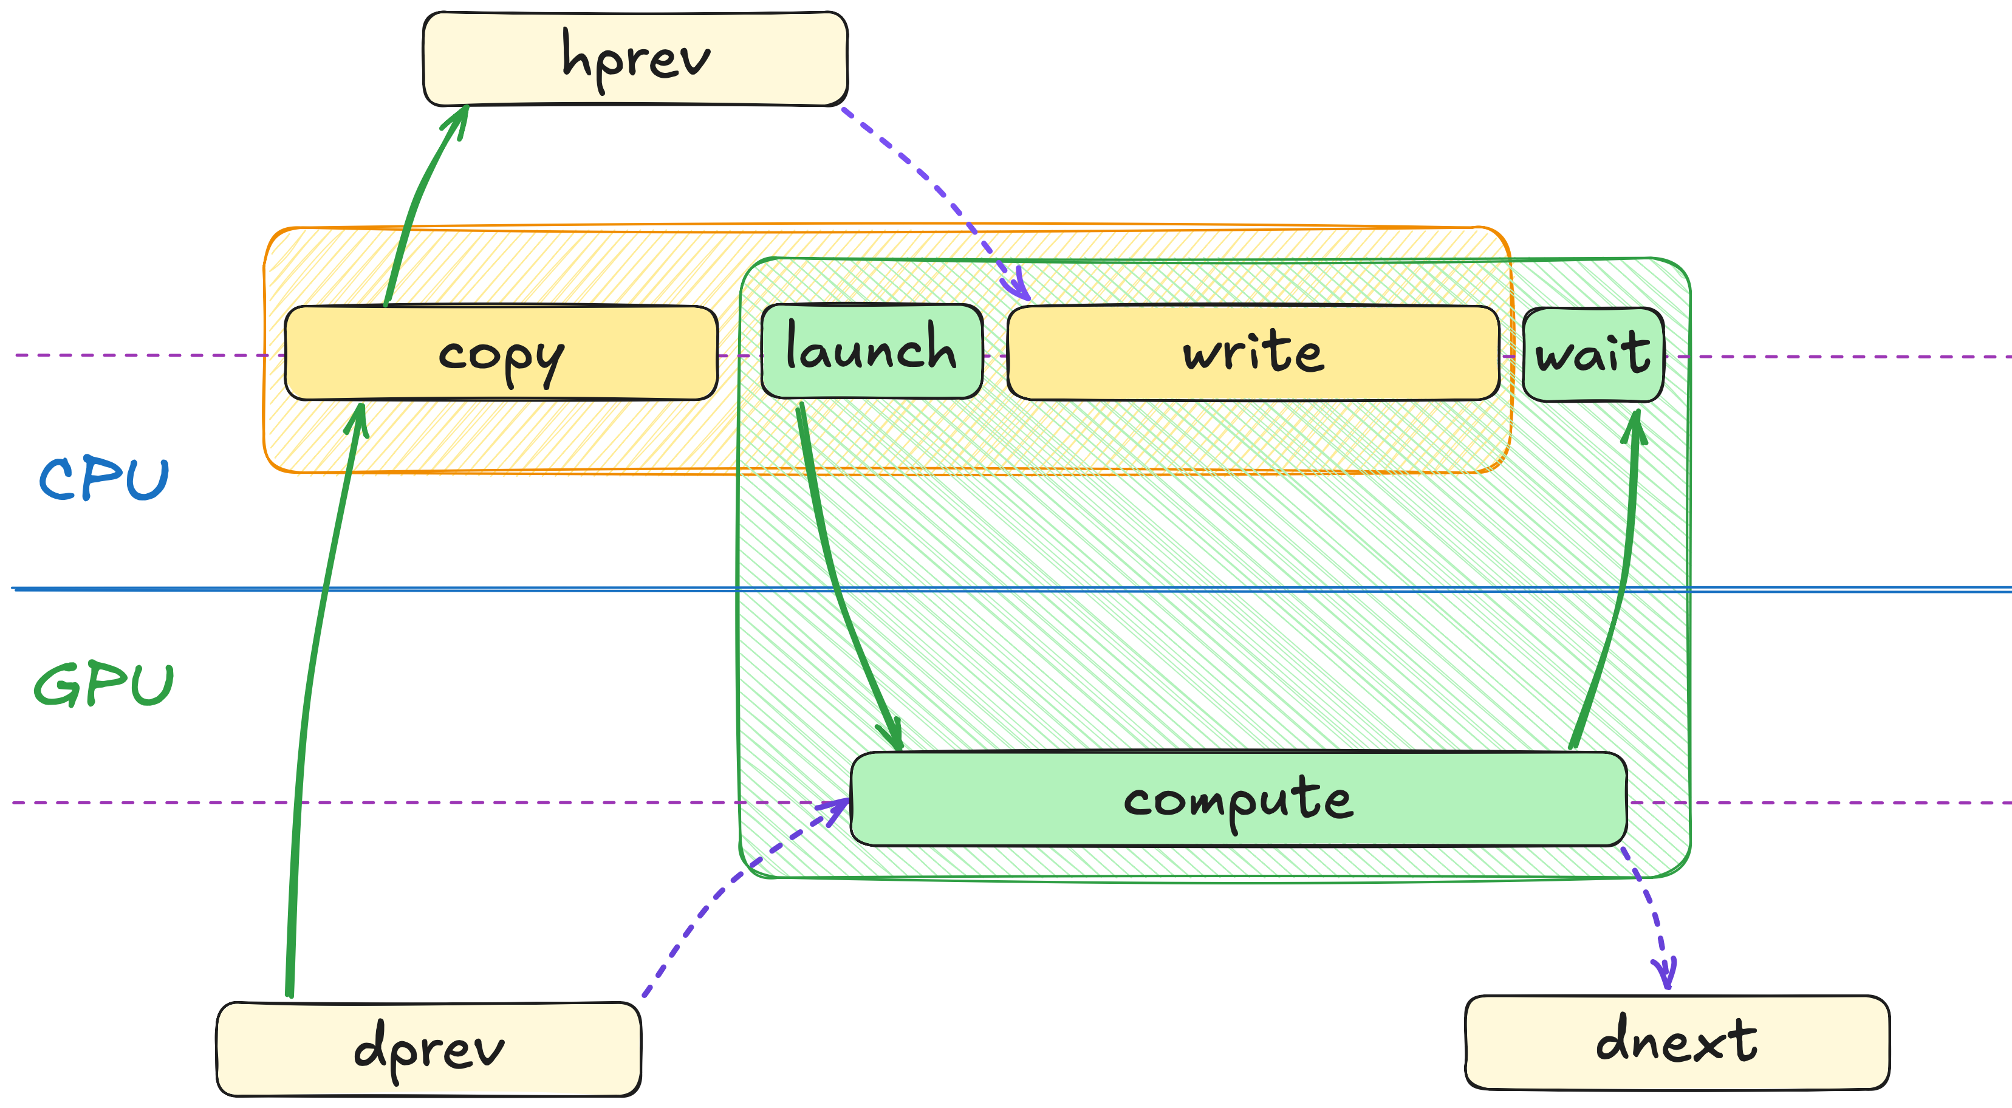
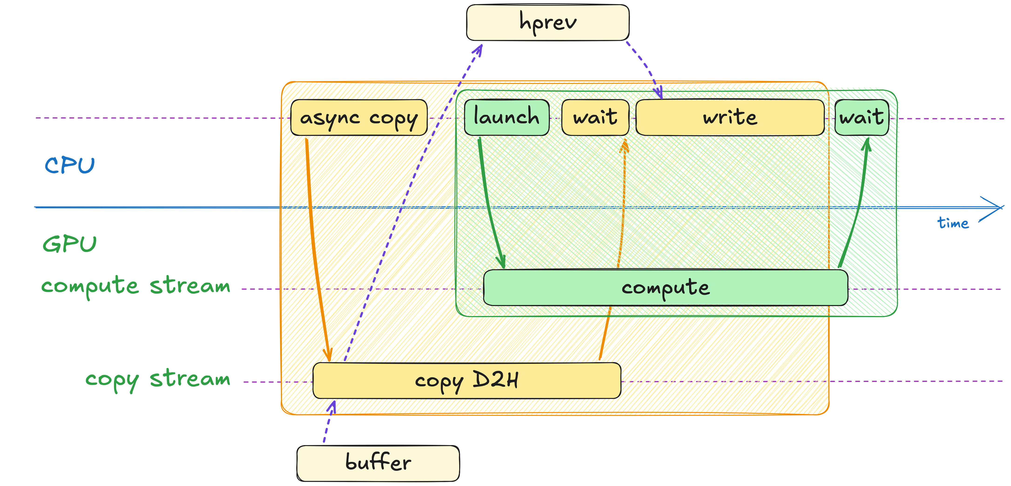
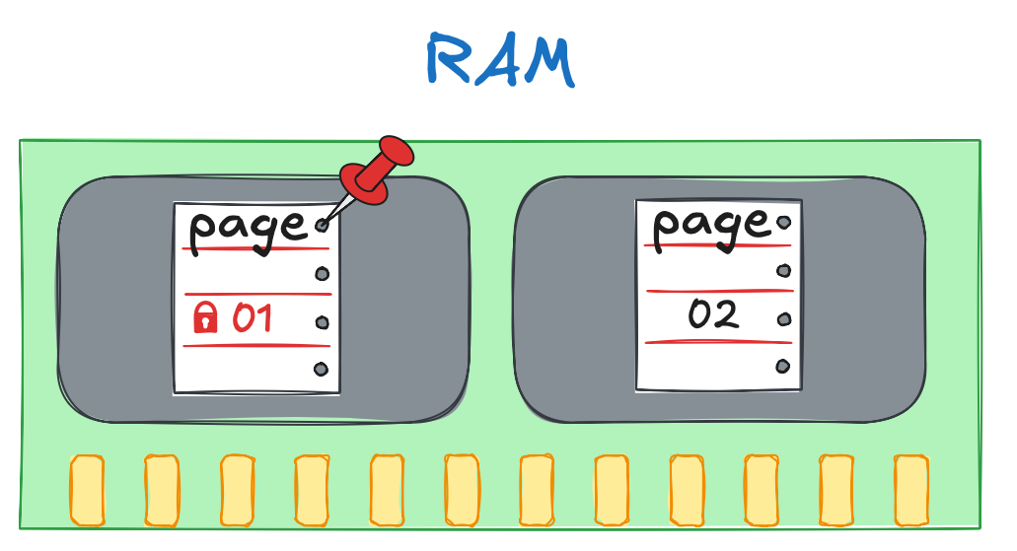
Final Review
Learn the notion of 2.2 Asynchrony as we overlap computation and IO to achieve 2x speedup
Learn the notion of 2.3 CUDA Streams as we overlap computation with memory transfers
Learn the notion of 2.4 Pinned Memory as we make memory transfers asynchronous

Slide 119
Final Review
Learn the notion of 3.2 CUDA Kernels as we implement our first CUDA algorithm
Learn about 3.3 Atomics Memory operations
Learn the notion of thread block 3.4 Synchronization
Learn the notion of 3.5 Shared Memory as accelerate out kernel and achieve 4x speedup
Learn the notion of 3.6 Cooperative Algorithms as we coarse the grid and accelerate IO

Slide 120
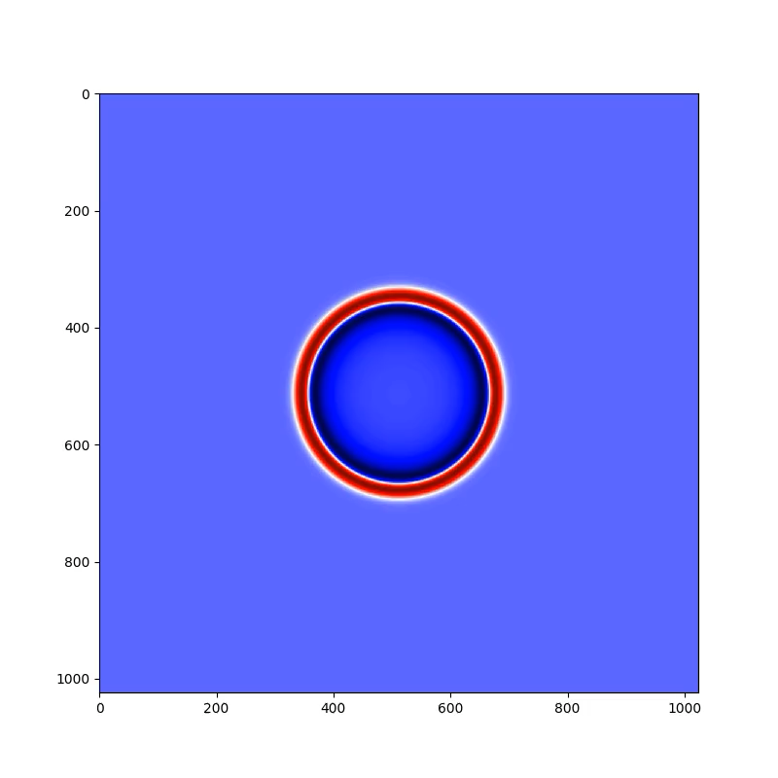
Final Assignment
Step 1
04.01-Assessment/assessment.ipynb
You are given a CPU simulator of Maxwell’s equations
As part of step 1, you are expected to:
Use explicit memory spaces instead of std::vector
Use explicit execution space specifiers
Use GPU-accelerated parallel algorithms instead of std::transform etc.
You are not expected to:
Understand the computations
Modify any of the lambda functions
Use fancy iterators (yet)
void update_hx(
int n, float dx, float dy, float dt, std::vector<float> &hx,
std::vector<float> &ez, std::vector<float> &buffer)
{
std::transform(ez.begin() + n, ez.end(), ez.begin(), buffer.begin(),
[](float x, float y) { return x - y; });
std::transform(hx.begin(), hx.end() - n, buffer.begin(), hx.begin(),
[dt, dx, dy](float h, float cex) {
return h - dli::C0 * dt / 1.3f * cex / dy;
});
}
...

Slide 121
Final Assignment
Step 2
04.01-Assessment/assessment.ipynb
You start with code from step 1
As part of step 2, you’ll have to:
Use fancy iterators to replace unnecessary materialization
Remove any temporary memory allocation remaining in the code from step 1
// Materialize cell indices (`i`) in memory
std::vector<int> cell_ids(cells);
for (int i = 0; i < cells; i++)
{
cell_ids[i] = i;
}

Slide 122
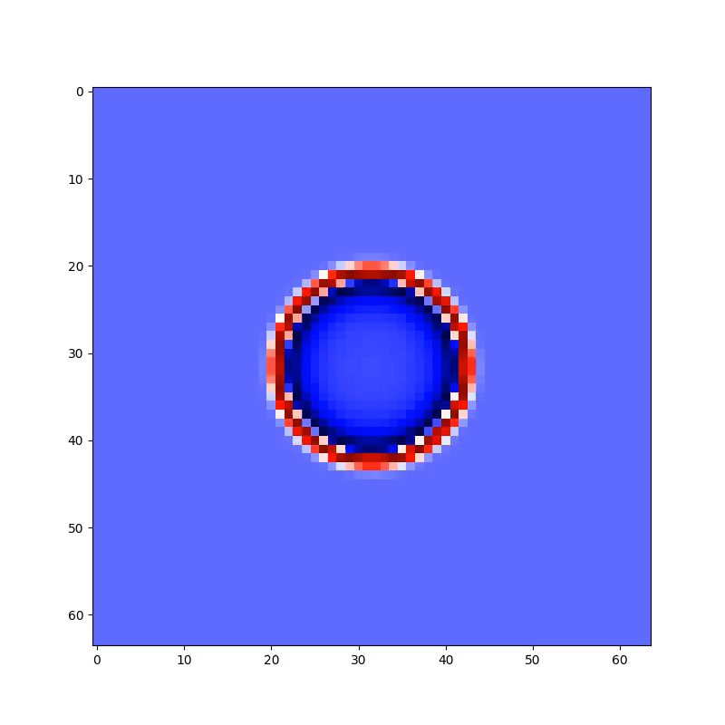
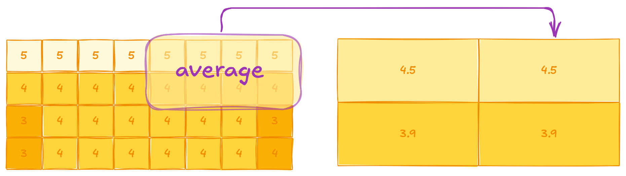
Final Assignment
Step 3
04.01-Assessment/assessment.ipynb
You start with code from step 2
As part of step 3, you’ll have to:
Use cub::BlockReduce to compute average temperature in a thread block to coarsen grid tile and save IO traffic
__global__ void kernel(
dli::temperature_grid_f fine,
dli::temperature_grid_f coarse)
{
...
float thread_value = fine(fine_row, fine_col);
float block_sum = ...;
coarse(coarse_row, coarse_col) = block_average;
}

